Slide 1
Recycling: The Business Case December 8, 2016 Webinar
Elemental Impact

Slide 2
Elemental Impact
Sustainability in ACTION
Work with industry leaders to create best operating practices where the entire value-chain benefits, including corporate bottom lines and the environment. Through education and collaboration, establish the best practices as standard practices.

Slide 3
A Catalyst
Ei Creates Corporate | Community Initiatives
What could be done
That is not being done
Ei gets it done
Brings the Possible out of Impossible
Identifies Pioneers & Creates Heroes

Slide 4
Platforms
Ei Platforms:
Product Stewardship
Integrity throughout the entire product life-cycle
Recycling Refinement
Moving beyond landfill diversion
Water Use | Toxicity
The Water Footprint: the new sustainability standard

Slide 5
Product Stewardship
Integrity throughout the entire product life-cycle
Engage the power of consumer demand
Work in partnership with supply chain
Focus: waste & toxins generated within raw material production
Focus: product’s impact on end user

Slide 6
Water Use | Toxicity
The Water Footprint: the new sustainability standard
Water use and toxicity addressed together
Reduce “spent water” released into sewer
systems | waterways with toxic chemicals

Slide 7
Recycling Refinement
Moving beyond landfill diversion …
Recycling Integrity:
Maintaining maximum Material Value With Minimal Energy Expended
Contamination:
an expensive trip to the landfill

Slide 8
Ei Recycling History
Ei’s Pioneering Role in Recycling
2009 – Launched the Zero Waste Zones (ZWZ) at an acclaimed press conference; established as THE national pioneer in commercial collection of food waste for compost.
2011 – Atlanta Airport (busiest airport in the
world!) became the first Sustainable Food
Court Initiative Pilot; followed by Simon Mall
Concord Mills & the Georgia Dome.

Slide 9
Ei Recycling History
Ei’s Pioneering Role in Recycling
2012 – Sold the ZWZ to the National
Restaurant Association.
2014 – Named NZWBC & USZWBC Official
Media Partner.
2016 – Published A Recycling or Contamination Crisis? an article series.

Slide 10
Ei: Respected Media
The ZWA Stats:
295,000 pageviews
335 published articles
Average 880 pageviews per article
Most popular article:
Reduce First, Donate Second, Compost Third (02/11)14,000 views; 925 views in last month

Slide 11
Contamination Crisis
A Recycling or Contamination Crisis? an article series
Published 11/06/16 – 1,600+ views
Intended series topics:
Waste Prevention – working within the value chain.
WE Consciousness | Culture – working together is key.
Hauler | Generator Responsibility - hauler & customer work together to craft recycling programs that generate clean streams and make solid business sense.

Slide 12
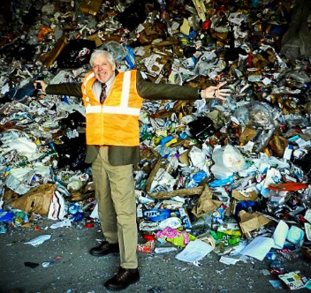
Contamination Crisis
A Recycling or Contamination Crisis? an article series
Intended series topics:
Clear Communication - educating employers and guests on proper placement for material and trash.
Local Infrastructure - working with grass
roots recycling companies on flexible
programs unique to the local end
markets

Slide 13
Recycling Business Model
Path to a Recycling Business Model:
Organization Culture | Top Management Buy-In.
Material Baseline Assessment | Local Available Infrastructure.
Clear Program Communication & Training.
Reward & Promote Successes.
Take Baby steps, lots & lots of baby steps.
not in chronological order!

Slide 14
Recycling Business Model
Organization Culture | Top Management
An organization’s culture dictates acceptable workplace behavior.
Top management is responsible for an organization’s culture.
Top management, in general, reports to the Board of Directors who “report” to the shareholders | owners.
Top management are stewards of the organization’s bottom line.

Slide 15
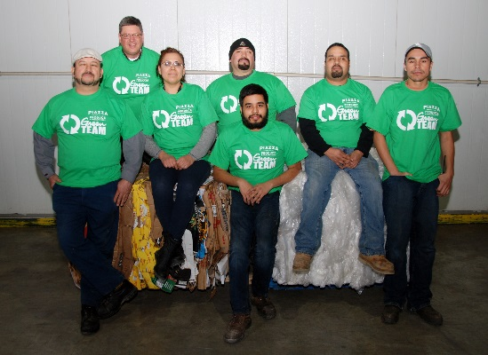
Recycling Business Model
Organization Culture | Top Management
Establish a “Recycling Team” with representatives from across operations and administration.
Team Leader must be in a decision
making position (or direct access).
Team participation is written into
employee job description.
Important at performance review time.
Team meets on a scheduled, regular basis.

Slide 16
Recycling Business Model
Organization Culture | Top Management
WE Consciousness is key to program success.
The Recycling Team establishes clear program practices where organization employees work together for common goals.
Employees are encouraged & rewarded to devise new practices that prevent waste or increase recycling
WE Consciousness extends beyond the organization to suppliers, purveyors, customers and the community at-large.

Slide 17
Recycling Business Model
Organization Culture | Top Management
Valuable material vs. trash perspective.
Employees must understand the value of their material discards.
Clean material is valuable; contamination reduces value or renders material landfill bound, an expense vs. revenue.
Recognition and sharing in program benefits.

Slide 18
Recycling Business Model
Creating a Recycling Baseline
Perform a waste | materials audit to determine the current scenario.
Third-party contractor – many will perform an audit, develop a recycling program, and charge based on cost-savings.
Green team attends the audit to literally see the valuable material taken to landfill – seeing is believing!
Top management benefits by attending the audit.
Document audit with video and still photos.
Make it fun and empowering!

Slide 19
Recycling Business Model
Creating a Recycling Baseline
Identify “easy wins” – high value & large quantity of material generated.
Determine the local end markets for material generated.
Discover local, grass roots recycling haulers – especially valuable if a small to moderate generator.
Commit to on-site source-separation.
Craft an organization map of where materials are generated to determine the best sorting methods

Slide 20
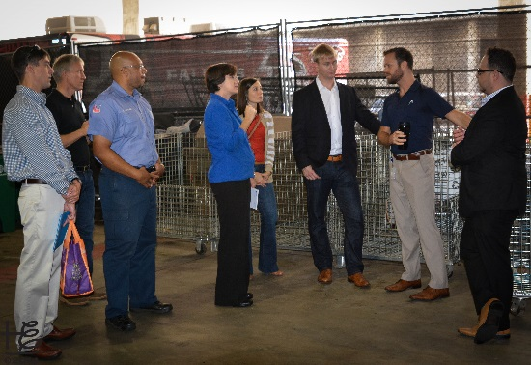
Recycling Business Model
Creating a Recycling Baseline
Employ WE Consciousness in program development:
Join the local | state recycling association – an invaluable resource.
Connect with the local, state & federal
government recycling departments –
excellent resource for industry
connections & support.
Meet with local companies with successful recycling programs – benefit from their lessons learned & recycling industry connections.

Slide 21
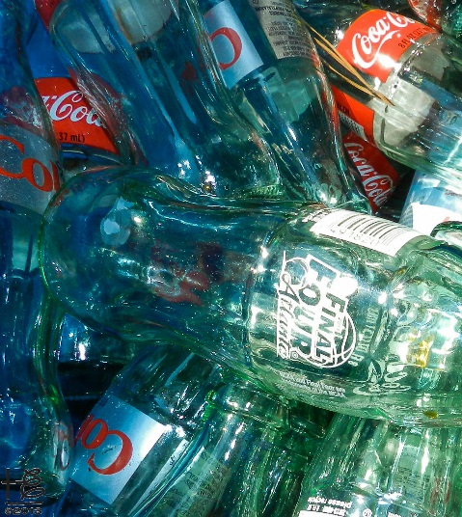
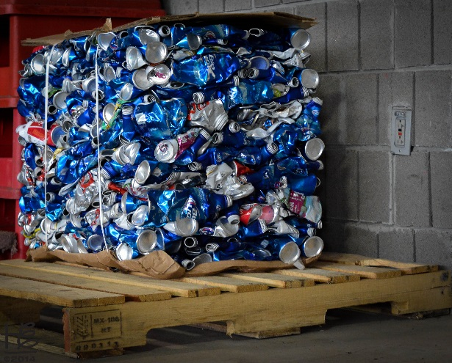
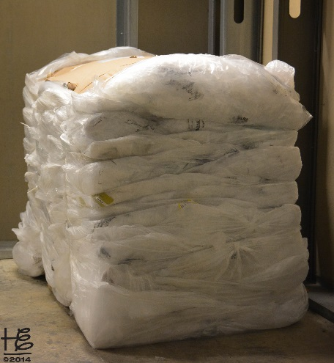
Recycling Business Model
Creating a Recycling Baseline
Source-separated CLEAN material is the foundation of a recycling PROFIT center! For smaller generators, dual- stream recycling (containers separated from fiber) may work great as long material does NOT go to a single-stream recycling MRF.

Slide 22
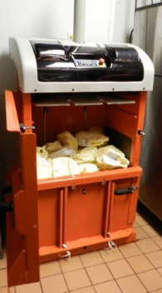
Recycling Business Model
Program Parameters:
Total Materials Management Approach
Evaluating the entire materials stream in one cost | revenue center.
Materials with solid end markets (e.g. aluminum, mixed paper, certain plastics) subsidize more challenging streams generated in operations such as food waste and glass.
Metrics system
Important to track | report program financial, tonnage
recycled and other successes.
Balers are key to on-site material source separation.
Mini-balers are perfect for small to moderate generators.

Slide 23
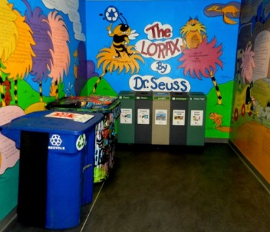
Recycling Business Model
Clear Communication & Training
Essential to establish program launch training.
Program administrators
Organization employees
Include the WHY’s and keep it light, fun!
Host a lunch ‘n learn for employees with recycling company associates.
Shows top management is serious about the program.
Recycling company associates may communicate the “cost of contamination” – brings a personal component to the impact of contamination.

Slide 24
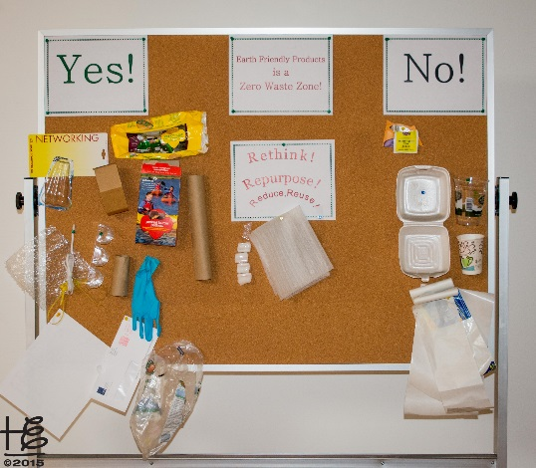
Recycling Business Model
Clear Communication & Training
Clear, multi-lingual signage is critical to proper disposal.
Use images where practical in signage
Use product samples where practical
Place recycling info graphics in employee
break areas.
Replace disposable breakroom food &
beverage serviceware with reusable where feasible.
If not feasible, only use recyclable | compostable items with nearby bins.
Address employees bringing “trash” to work.

Slide 25
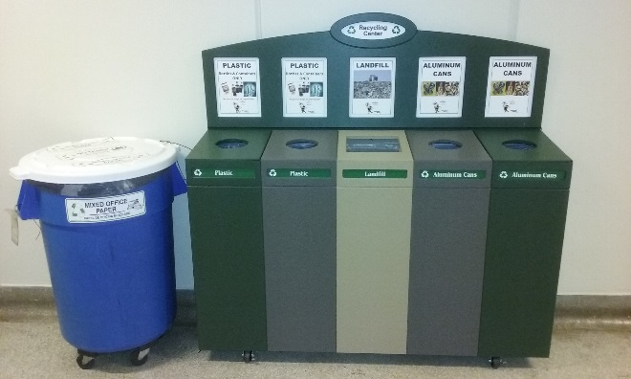
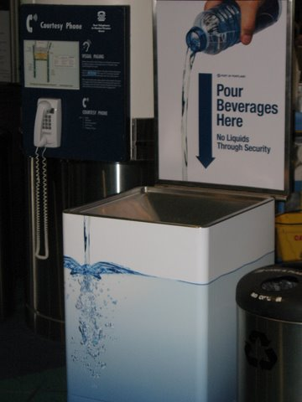
Recycling Business Model
Clear Communication & Training
“Best Bin Practices” for common areas.
Always place trash & recycling bins together.
Use bins with holes that match the material
collected.
Place signage at eye level.
Use material images to convey proper sorting.
Strategically place recycling centers in high traffic areas.
NOTE: melted ice is a BIG contaminant in recycling streams
where plastics & paper are together.
Collect containers separate from fiber.
Include a disposable option for ice where practical.

Slide 26
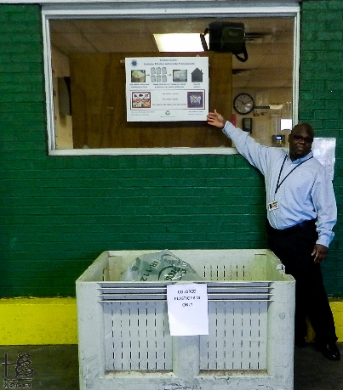
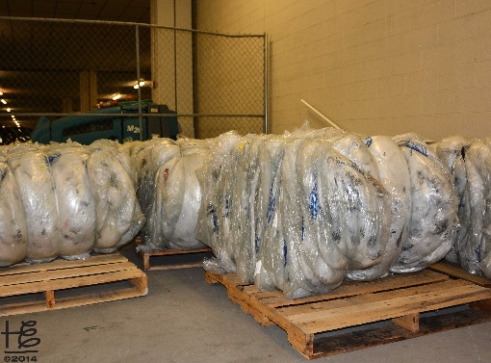
Recycling Business Model
Clear Communication & Training
Back-of-the-house recycling system
Most likely where majority of high value &
volume is collected.
Set-up a recycling center in a convenient place.
Standard-sized and mini balers are integral for material sales.
Gaylords work well to separate material – include
clear, eye-level signage.
Forklifts are useful for moving bales.
Storage area to accumulate sufficient material
for a recycling hauler to collect is important.

Slide 27
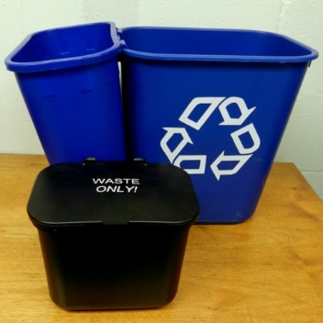
Recycling Business Model
Clear Communication & Training
Administrative recycling system
Require active participation.
Recycling is collected by janitorial staff; trash is taken to landfill bin by employee.
Provide written recycling program info.
Clear, concise along with visuals.
Keep it light with humor added.
Monitor program for contamination | mistakes.

Slide 28
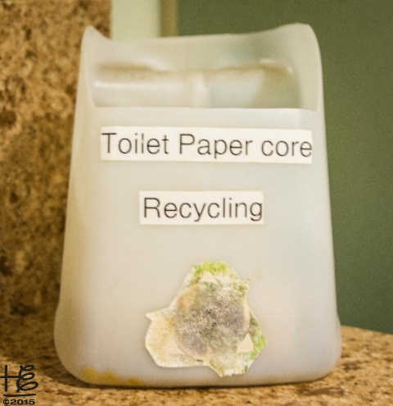
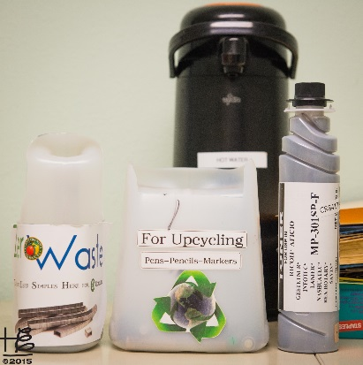
Recycling Business Model
Clear Communication & Training
Administrative recycling system
Janitorial staff | contractor must be on-board.
Use the WE Consciousness approach with
janitorial staff.
Include recycling collection provisions upon
contract renewal.
Be creative & inclusive for common area
recycling.
Ask for employee input & reward great suggestions.
Examples: toilet paper cores, printing cartridges, pencils etc.

Slide 29
Recycling Business Model
Recognize & Promote Success
Employee Recognition
Recycling Team
Include in job description – imp for performance reviews.
Schedule regular meetings to keep momentum moving and to understand any program glitches.
Share team member responsibilities within internal communications.
Organization Associates
Offer lunch and learn recycling education sessions.
Encourage ideas for waste reduction and material collection for recycling.
Recognize successful suggestions.
Consider a bonus program based on recycling program profits.

Slide 30
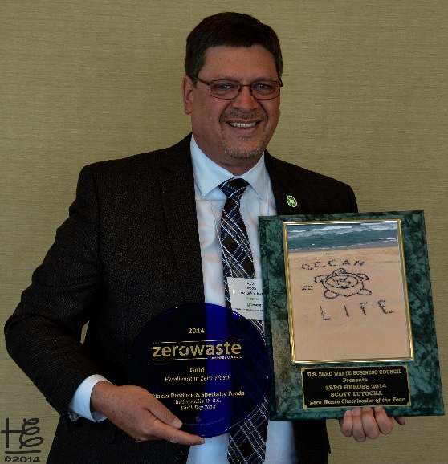
Recycling Business Model
Recognize & Promote Success
Community Recognition
Quantify recycling program stats including quantities
recycled & profit.
Issue press releases on recycling successes.
Encourage Recycling Team members to serve on
industry conference panels, webinars and other
educational platforms.
Consider applying for Zero Waste Facility Certification.
Share challenges, lessons learned and success with industry colleagues.

Slide 31
Recycling Business Model
Take baby steps
lots & lots of baby steps!

Slide 32
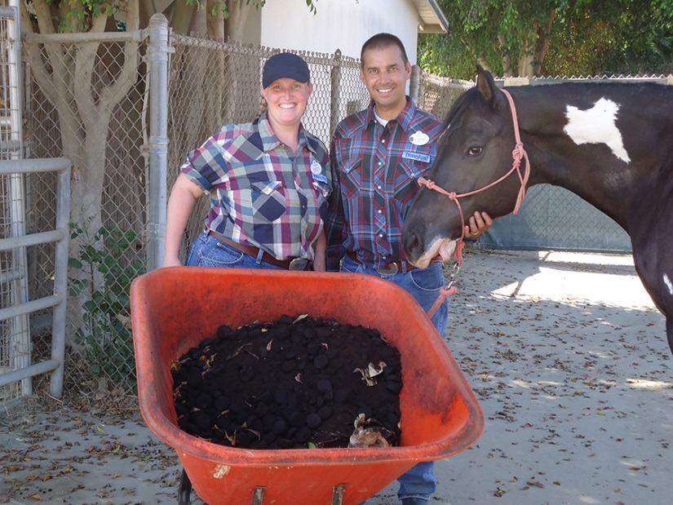
Recycling Success Cases
Walt Disney Parks & Resorts
Circle D Corral:
USZWBC Zero Waste Facility Certified
Recycles paper, cardboard,
and metal.
Composts hand towels,
coffee grounds, and
laundry lint (organic cotton
material).

Slide 33
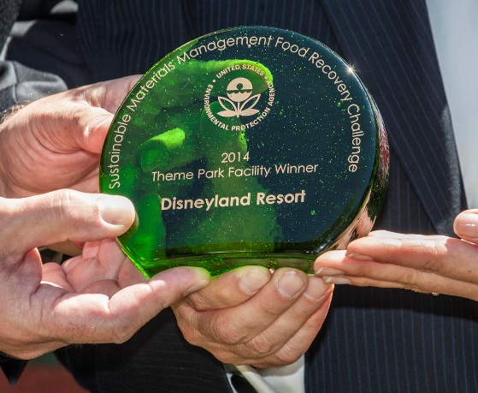
Recycling Success Cases
Walt Disney Resorts
Walt Disney World Resort:
Harvest Power Anaerobic Digester –
1st food waste customer.
Disney Harvest – donates excess
prepared food; feeds more 1,400 children weekly;
2014 donated 720,000 lbs. of food to the hungry.
Animal Kingdom Theme Park – 2014 4,000 tons of manure sent to local compost facility.

Slide 34
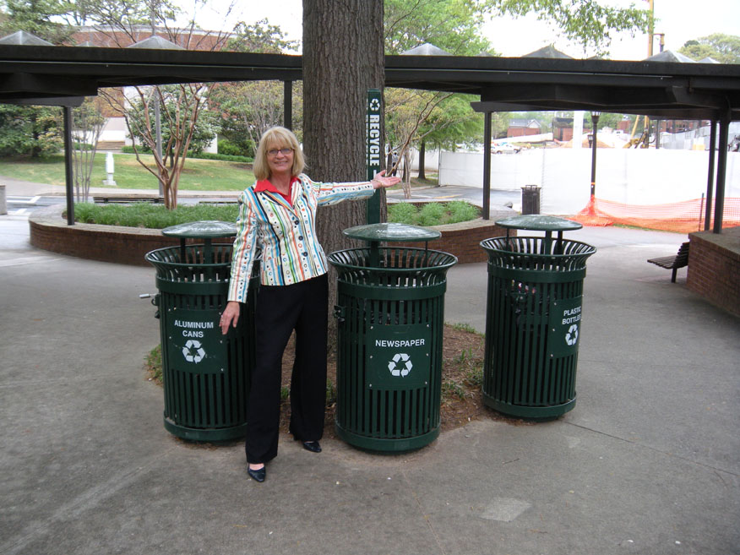
Recycling Success Cases
Georgia Institute of Technology
Award Winning Recycling
Program
Home of the
AMAZING Cindy Jackson
Never succumbed to single-stream recycling!

Slide 35
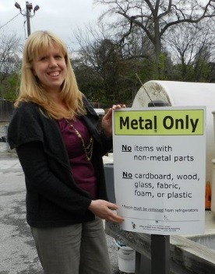
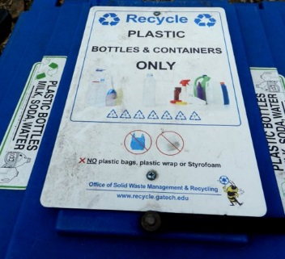
Recycling Success Cases
Georgia Institute of Technology
FY2016 Recycling Stats:
Cardboard - 829,176 lbs.
Food waste & organics – 743,401 lbs.
Metals - 709,548 obs. ($25,026)
Office paper – 426,284 lbs.
Plastics – 44,454 lbs.
Glass – 21,020 lbs. ($214)
Pallets – 15,470 lbs. ($442)
Aluminum – 15,420 lbs.
REVENUE: Cardboard, aluminum, plastic - $34,120.
TOTAL RECYCLING REVENUE: $60,242
The above is revenue (in red )only without reflecting related cost-savings.
Never succumbed to single-stream recycling!

Slide 36
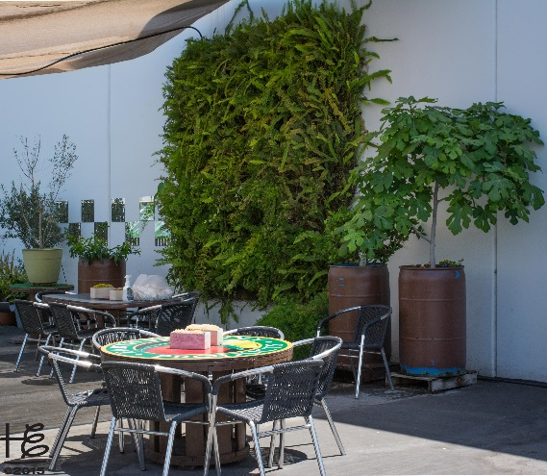
Recycling Success Cases
Earth Friendly Products
Five U.S. plants Zero Waste Facility Certified, Platinum level.
Strong employee education &
engagement program.
Corporate culture extends beyond
recycling to overall sustainability &
employee health (mental, physical & entire Being)

Slide 37
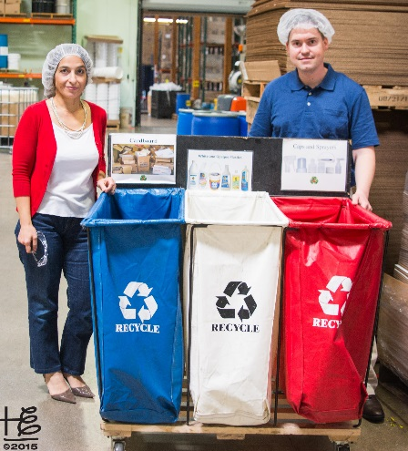
Recycling Success Cases
Earth Friendly Products
Strict Recycling Standards:
Separating all recyclable materials and
being vigilant in reducing consumption,
working closely with suppliers, and
vendors to prevent waste.
Donating packaging materials (Styrofoam peanuts) to UPS stores.
Providing reusable cups and plates for employees.
Banning Styrofoam cups, plates and containers.

Slide 38
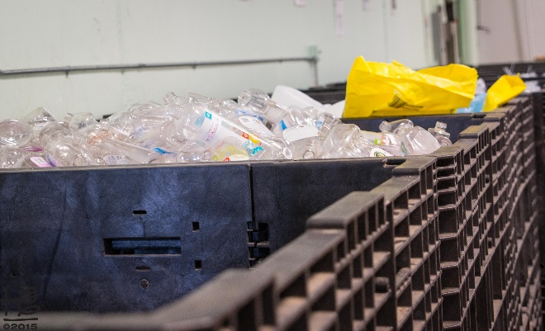
Recycling Success Cases
Earth Friendly Products
Financial Success:
2015 recycling profit = $21,556
2011 – 2015:
Recycling sales = $205,238
Reduced disposal costs = $112,902
Recycling profit = $318,140

Slide 39
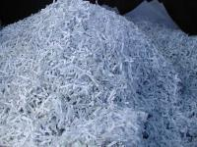
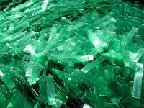
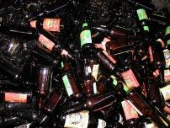
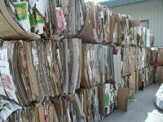
Recycling Success Cases
Sierra Nevada Brewing
FIRST Zero Waste Facility Certified Platinum level awarded!
Source-Separation brings in revenue!
Cardboard, shrink wrap, glass, can bottles, paper, plastics, batteries, light tubes, computers, construction debris, wood

Slide 40
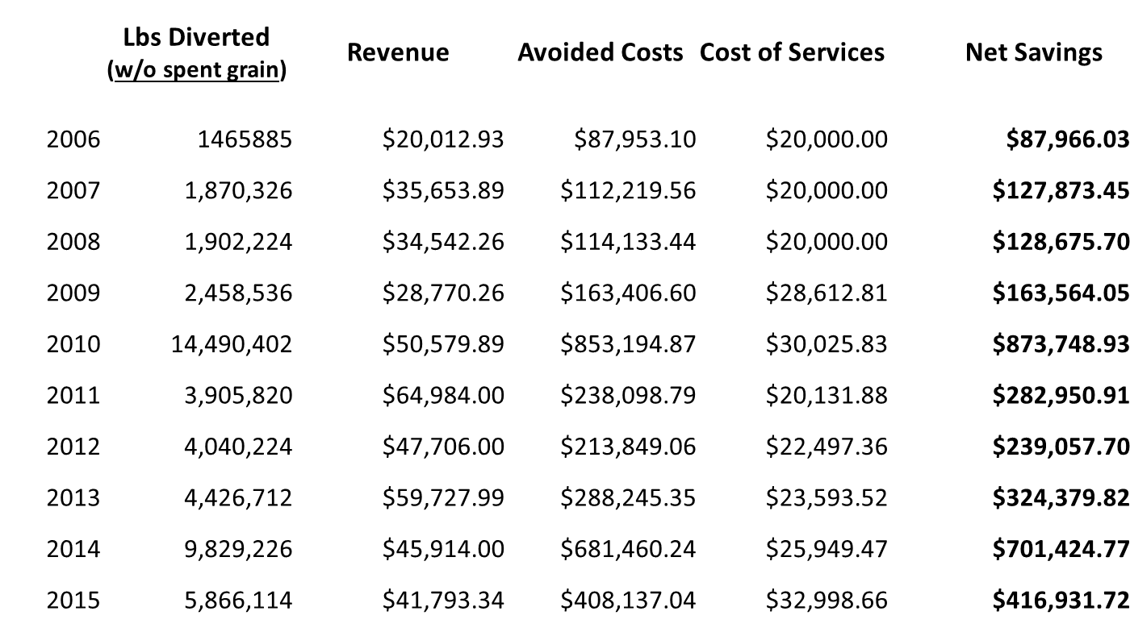
Recycling Success Cases
Avg Net Savings = $335,000

Slide 41
Recycling Success Cases

Slide 42
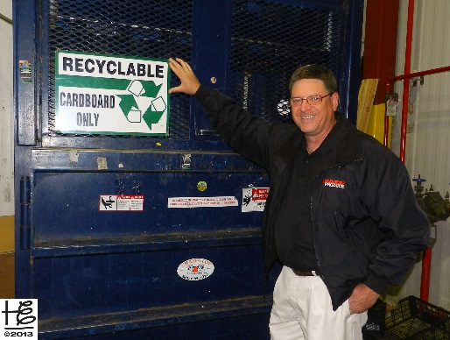
Recycling Success Cases
Piazza Produce
Distribution Center Zero Waste
Facility Certified Gold level.
2015 Recycling PROFIT = $288,034
Famous Piazza Produce Facilities Mgr Scott Lutocka quote:
“There’s Ca$h in Your Tra$h!” and “You don’t know what you don’t know (about the value in your waste stream)!”

Slide 43
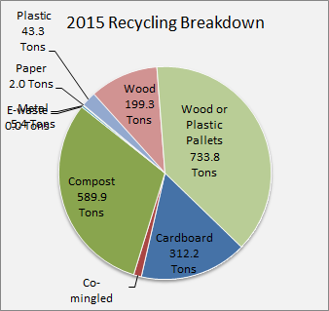
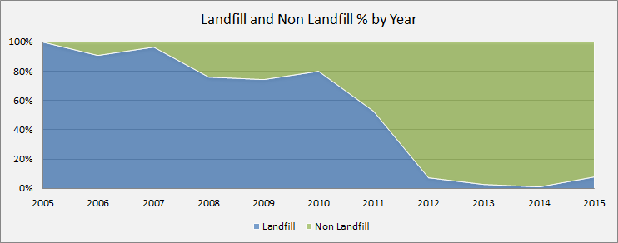
Recycling Success Cases
Piazza Produce

Slide 44
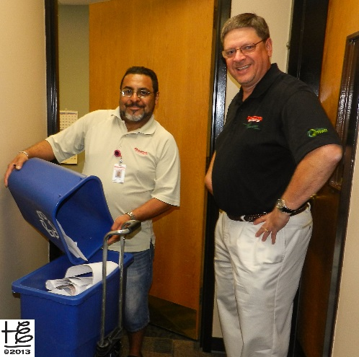
Recycling Success Cases
Piazza Produce
Keys to creating a recycling PROFIT Center:
Clean source-separation of material.
Teamwork across company department
boundaries.
Working closely with recycling partners.
Total recycling, compost, & waste diversion savings 2006 through 2016: $1.75 Million Dollars!

Slide 45
Contact Information
Holly Elmore
holly@elementalimpact.org
404.261.4690
/elementalimpact
@elementalimpact

