Slide 1
Organics Recovery & Biobased Materials: Opportunities for Corporate Involvement
Brenda Platt SBC Co-Chair
Institute for Local Self-Reliance
January 24, 2011 POWER Meeting, Santa Clara, California

Slide 2
Overview
Petro-plastic woes
Why recover organics composting?
What are biobased products and how can they help?
Understanding difference between biobased vs biodegradable vs compostable
Compostable alone ≠ sustainable
Criteria for environmentally preferable biobased food service ware
Market-based tools: purchasing specs & Working Landscape Certificates
Other corporate opportunities

Slide 3
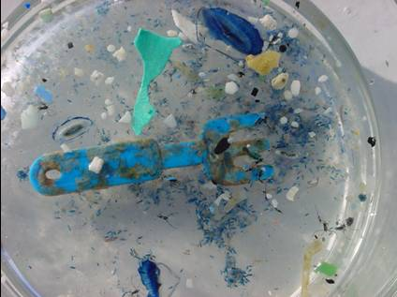
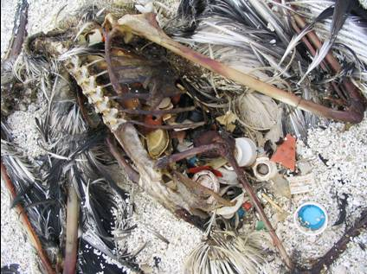
Petro-Plastic Woes
Non-renewable (geological timeframes to produce but consume in 1 to 10 years)
Generally nonbiodegradable with devastating affects on ocean life
Demand and production skyrocketing
Plastics industry supports more drilling
Recycling and reuse low
Health impacts (polymers differ)
6 times more plastic than plankton by mass
Agalita Marine Research Foundation
Notes:
What’s so bad about fossil fuel-based plastics? Lots.

Slide 4
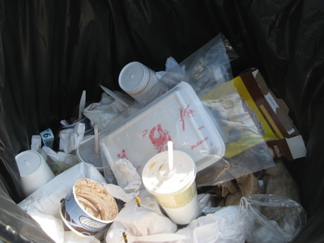
How Exposure to Polystyrene Affects the Human Body
Polystyrene in made from the monomer styrene (vinyl benzene)
Styrene remains present in polystyrene (no polymerization process is 100% efficient)
Styrene = a neurotoxin and suspected human carcinogen
Styrene impairs the central and peripheral nervous systems.
Exposure to styrene in the workplace has also been associated with chromosomal aberrations, thus is considered a mutagen.
Carcinogenic Effects: Proven that it causes cancer in animals, but there are no long-term studies showing that PS causes cancer in humans.
“The ability of styrene monomer to migrate from polystyrene packaging to food has been reported in a number of publications and probably accounts for the greatest contamination of foods by styrene monomer.” – World Health Organization

Slide 5
Plastics Recycling: Failure?
Thousands of tons
Source: US EPA, 2007 data (http://www.epa.gov/epaoswer/non-hw/muncpl/msw99.htm)
Notes:
In 2007, 6.8% recycled

Slide 6
Plastics Recycling Low
 | Generation (thousand tons) | Recycling (thousand tons) | Recycling Level (percent by weight)
PET | 3,760 | 680 | 18.1%
HDPE | 5,650 | 570 | 10.1%
PVC | 1,660 |  | 0.0%
LDPE/LLDPE | 6,400 | 310 | 4.8%
PP | 4,570 | 10 | 0.2%
PS | 2,620 | 20 | 0.8%
Other resins | 6,070 | 500 | 8.2%
Total Plastics in MSW | 30,730 | 2,090 | 6.8%
Source: US EPA, 2007 data
Notes:
Soft drink containers, 36.6% recycling rate
HDPE milk bottles, 28% recycling rate
Other containers, 14.1%

Slide 7
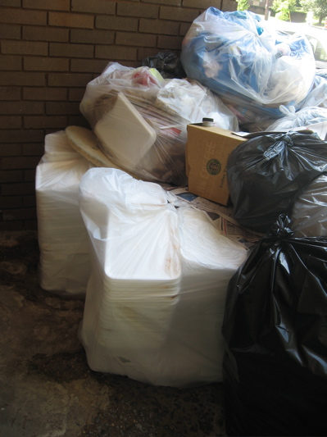
U.S. municipal waste disposed
169.2 million tons in 2007
Source: US EPA, 2007 data (http://www.epa.gov/epaoswer/non-hw/muncpl/msw99.htm)
Notes:
Food scraps = 30.84 million tons
Plastics = 28.64 million tons
In food service ware:
30.8 million tons of food scraps were landfilled and burned in the US in 2007 (latest US EPA figures)
2.2 million tons of plates and cups landfilled and burned in the US
of this, 890,000 tons were polystyrene plates and cups!
by moving toward reusable and compostable food service ware, we can help capture that 30.8 million tons of food scraps for composting.

Slide 8
Benefits of Biobased Alternatives
Can replace many harmful conventional plastics
Can be fully biodegradable (capable of being utilized by living matter)
Can be made from a variety of renewable resources
Can be composted locally into a soil amendment
Can help capture food discards
Can contribute to healthier rural economies
Can complement zero waste goals

Slide 9
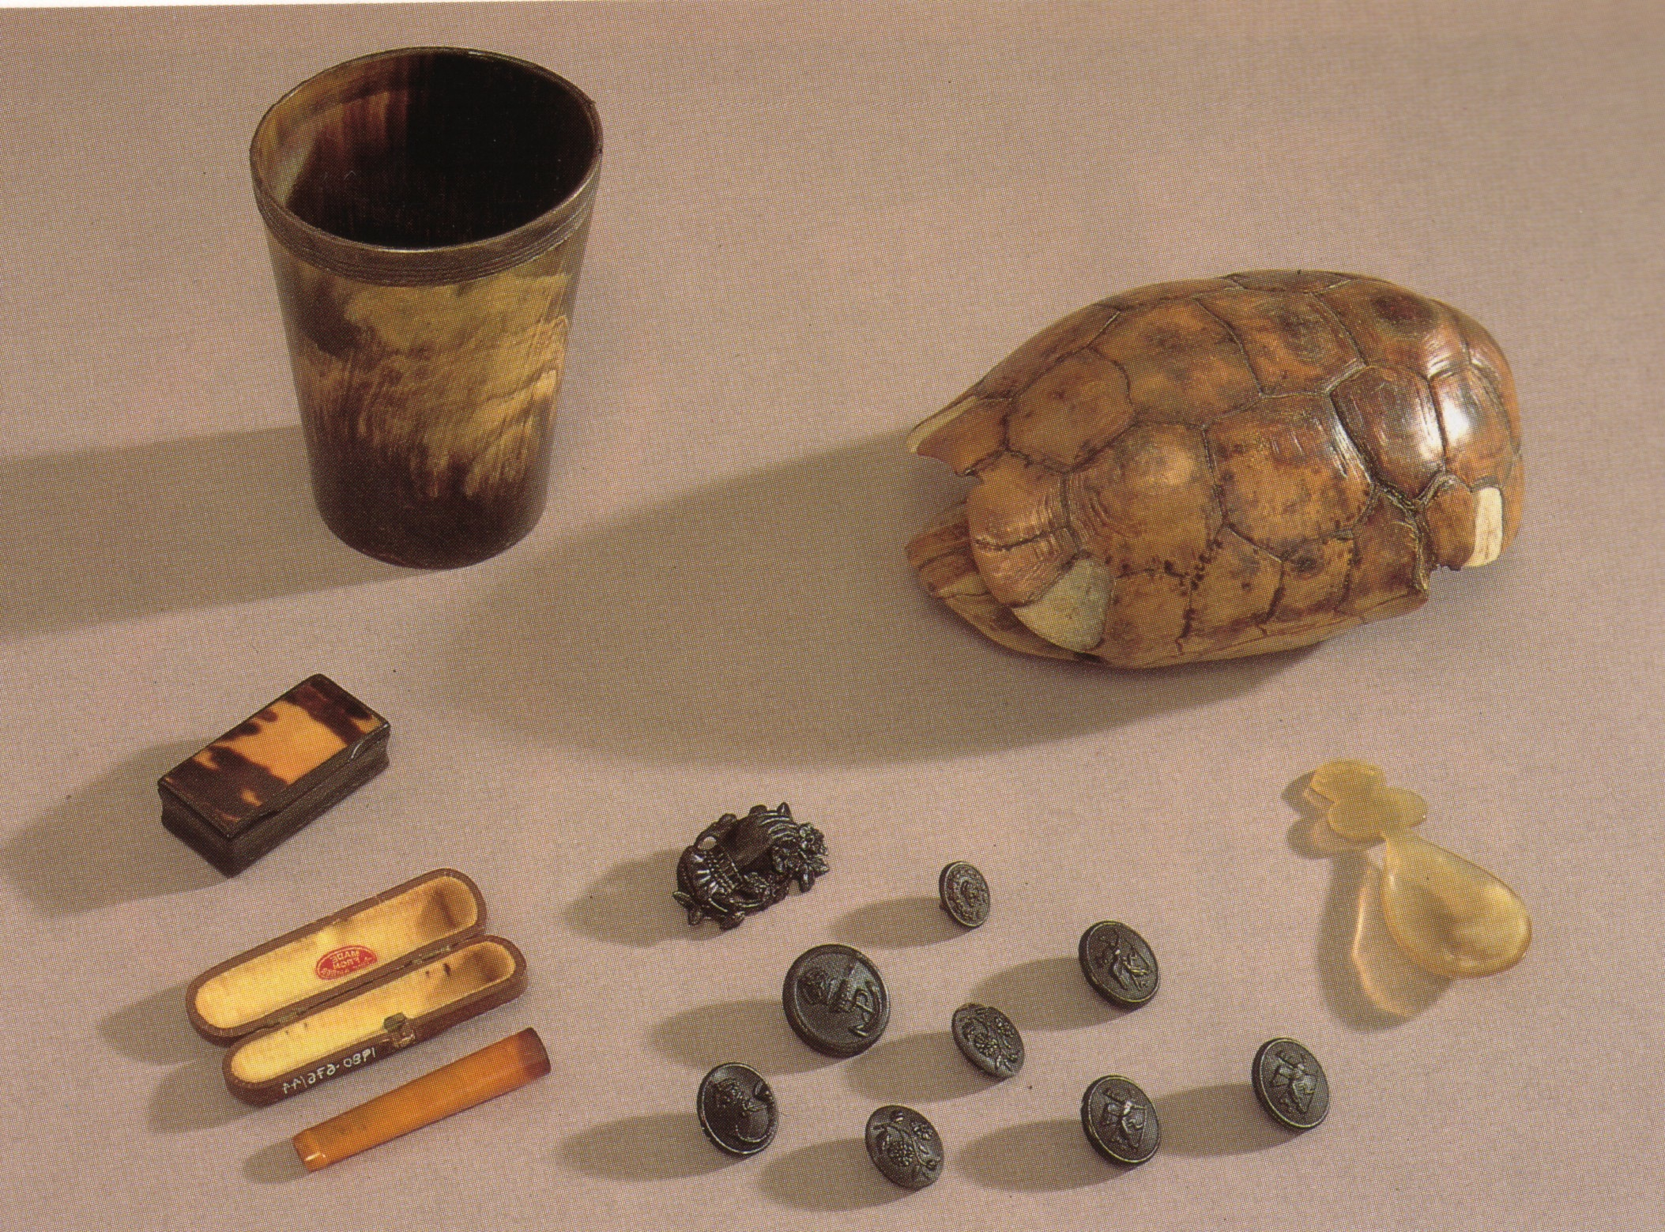
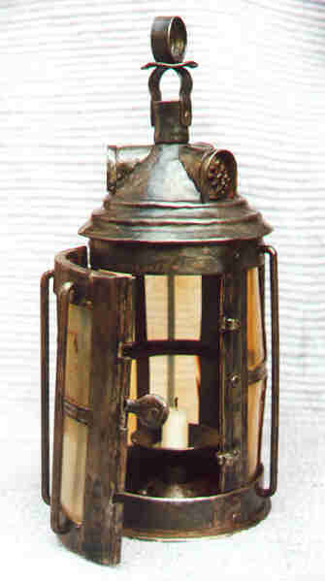
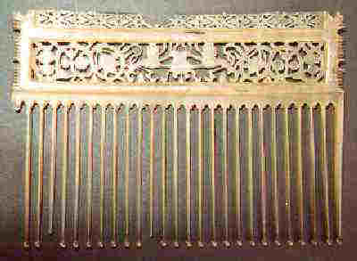
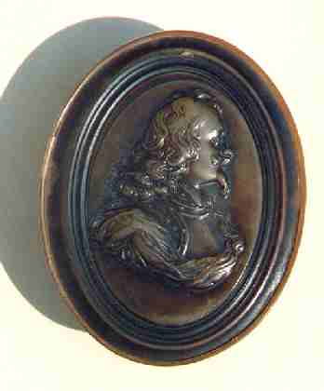
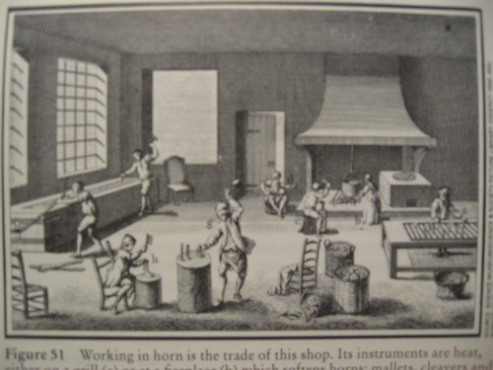
Horn, Tortoiseshell, Amber
Source: Susan Mossman, ed., Early Plastics: Perspectives 1850-1950 (Science Museum, London: 1997), Plate 2 & Fig 51; www.horners.org.uk.
Notes:
Less than 200 years ago, our economy was a carbohydrate economy.
Plants were the primary raw material in the production of dyes, chemicals, paints, inks, solvents, construction materials, even energy.
The first plastics were bio-based plastics. They were horn, amber, tortoiseshell, shellac, gutta percha and natural rubber. These materials have been used and molded into many different shapes for centuries. Remember. The common dictionary definition for a plastic: “Capable of being molded or shaped into different forms under pressure and/or heat. As opposed to non-plastic substances which must be cut or chiseled
Methods used to mold natural plastics such as heating and pressure molding were later adapted to make semi-synthetic and synthetic plastics. The first injection molding machine was developed for a bio-based plastic.
Ancient Egyptians molded amber, a fossilized resin from trees, into items such as jewelry. Amber cigarette holder.
Horn used as windows in lanterns, to make knife handles, spoons, molded boxes, drinking cups, and in the 19th Century as a substitute for glass. Impt use was to produce combs, particularly between 1770 and 1880. Horn was pressed into flat sheets and molded into simple shapes [p. 16]
Lantern with horn panes-19th C Comb-1694 Tobacco box- early 18th C
Horn shop: soften horn with heat, press to mold softened horn into desired forms

Slide 10
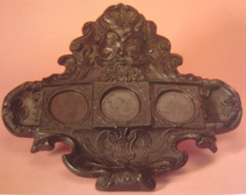
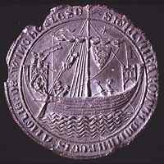
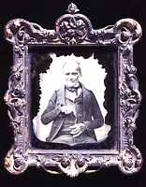
Gutta Percha
Source: Susan Mossman, ed., Early Plastics: Perspectives 1850-1950 (Science Museum, London: 1997), Plate 3; and Plastics Historical Society (London) http://www.plastiquarian.com/gutta.htm.
Notes:
Gutta percha, a relative of rubber, comes from trees native to Malaysia. Could be shaped by softening over heat and pressed into molds as well as extruded. Extrusion process based on early 19th century devices used in Italy to make pasta, and was adapted to produce rods and tubes of gutta percha. Had excellent insulating capabilities and was used to cover the first submarine cable between France and England in 1851. The 1st transatlantic cable was laid in 1866.
[gutta percha inkstand c1851, with head of Neptune. Made to commemorate the laying of the 1st transatlantic cable]

Slide 11
Shellac: Lac Beetle Secretion
Union Cases (1854-1870s)
Mirrors
Seals
Gramophone 78 rpms (1897-1940s)
Source: Susan Mossman, ed., Early Plastics: Perspectives 1850-1950 (Science Museum, London: 1997), Plate 4.
Notes:
Shellac is the refined secretion of the lac beetle, which lives on certain trees primarily in India, Burma, and Thailand. Harvested since ancient times. Became popular in latter half of the 19th century for molding into a variety of shapes.
In 1854, American Samuel Peck patented technique for combining gum shellac and woody fibers and pressing into molds. Could pick up intricate detail. He made Union Cases, popular as holders for the photographic equivalent of the period. These early photographs faded in the light.
1897 – used to make gramophones 78 rpms (15% shellac resin, 85% ground slate and carbon black). Superceded in 1948 by vinyl records, which now have been superceded by PC CDs. Vinyl was less brittle, more flexible than shellac, reduced noise.

Slide 12
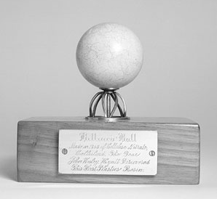
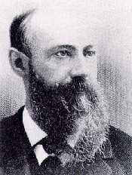
John Hyatt’s Billiard Ball
http://home.planet.nl/~kockpit/history.htm
Copyright Smithsonian National Museum of American History, http://americanhistory.si.edu/collections/object.cfm?key=35&objkey=18
"Made in 1868 of Cellulose Nitrate, Celluloid. The Year John Wesley Hyatt Discovered This First Plastics Resin."
Notes:
In the 1860s, the largest manufacturer of billiard balls in the US offered a $10,000 prize to anyone who could make artificial billiard balls. They were worried that at the rate African elephants were being killed, the supply of ivory would soon end. The firm wanted a product with properties similar to ivory, yet derived from a more abundant material. John Wesley Hyatt, a young printer in Albany, NY, began experimenting. He made balls of wood pulp, cloth, and paper bound together with adhesives such as shellac and various resins, compressed into a sphere under high temperature and pressure. He patented the ball in 1865 but it was unsuccessful as it did not have the same hardness and feel as the ivory balls.
He and his brother Isaiah Smitth Hyatt began experimenting with the cellulose nitrate. They coated the balls with almost pure gun cotton. Didn’t have a long life as a billiard ball. The plastic, cellulose nitrate, is more popularly known as gun cotton, a mild explosive. Not a good material for pool balls.
Hyatt wrote: “Consequently a lighted cigar applied would at once result in a serious flame and occasionally the violent contact of the balls would produce a mild explosion like a percussion guncap. We had a letter from a billiard saloon proprietor in Colorado, mentioning this fact and saying that he did not care so much about it but that instantly every man in the room pulled a gun.”
The Hyatt brothers knew of work done by Parkes making a cellulose nitrate dough. They learned that what Parkes had considered a minor additive – camphor oil (obtained from the laurel tree on the island of Formosa) was actually a key solvent in producing a more workable, stable material. Isaiah named the new compound “celluloid,” for “cellulose-like.” Because it could be remelted and used over again, celluloid was the first thermoplastic material.
In the 1870s, the Hyatts started the Albany Billiard Ball Company and the Albany Dental Plate Company, which later they combined to form the Celluloid Mfg Company. Flammability was a problem. The Dental Plate Co was plagued by occasional reports of exploding dentures by cigar smokers.

Slide 13
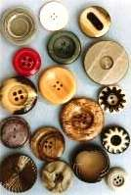
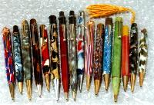
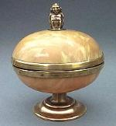
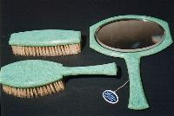
Casein
Made from milk curds or skimmed milk (protein based)
Source: Plastics Historical Society (London) http://www.plastiquarian.com/casein1.htm
Notes:
Casein is an early plastics made from either milk curds or skimmed milk (protein-based). Developed in Germany at the end of the 19th Century. The enzyme rennet was used to precipitate casein out of skimmed milk; the casein was ground to a powder, mixed with water, then, when absorbed, fed into an extruder; the extruded rods could be sliced into button blanks, pen barrels etc or used for molding sheet. It was used to make a wide variety of buttons in various colors and finishes. Fish scales were added to produce the pearlized effect found in many casein buttons. Still used today to make the more expensive buttons.

Slide 14
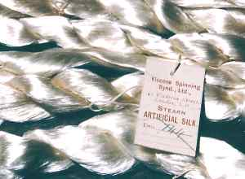
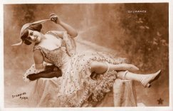
Chardonnet Silk
Nov. 21, 1889
Source: Plastics Historical Society (London) www.plastiquarian.com; www.museum-of-hosiery.org; and New York Times archives.
Notes:
In 1884, Frenchman Comte Hilaire de Chardonnet patented artificial silk. He first used fibers from the bark of the mulberry tree but later used cotton, which was cheaper and more abundant. Caused sensation at the 1889 Paris Exhibition, garnered the Grand Prix. At first, commercially successful, however, Chardonnet silk was very flammable. Joke at time: ideal present for a mother-in-law – box of matches and a dress of Chardonnet silk. French government banned the production of Chardonnet silk in France.
By the early 1920's there were two types of sheer stockings on the market for ladies to choose: silk and artificial silk. The manufacturers thought that the word "Artificial was not very appealing, so they held a competition for a new name with a prize of $1,000. 10,000 entries. Didn’t like them. The committee decided to choose the word rayon taken from the French for "rays of light.” From 1924, "Artificial Silk" was known as Rayon.
For the very first time you could see ladies legs. Hosiery became more of a fashion accessory than ever before. Growing market.

Slide 15
Henry Ford’s Biological Car (1941)
body: variety of plant fibers
dashboard, wheel, seat covers: soy protein
tank: filled with corn-derived ethanol
Notes:
In the 1910s Henry Ford experimented with using agricultural materials in his automobiles. Ford was partly motivated by a desire to find nonfood applications for agricultural surpluses. He tried out many agricultural crops, including wheat. Eventually he focused on soybeans, and in the 1920s began promoting soybean products at every opportunity. He recruited Robert Boyer, a young chemist, to lead the research. In the following few years, uses were found for soy oil in automobile paints and enamels, in rubber substitutes, and in the production of glycerol for shock absorbers. Viscous solutions of soy protein were extruded to form fibers for upholstery cloth. But Ford’s special interest was in converting soy meal into plastics.
Soy meal plastics were used in glove-box doors, gear-shift knobs, horn buttons, accelerator pedals, distributor heads, interior trim, steering wheels, and dashboard panels. Finally Ford gave the go-ahead to produce a completely prototype "plastic car," including an entire plastic body. Ford exhibited the prototype with great fanfare in 1941.
Observing that Ford’s plastic was molded from soybeans and other crops, including wheat, hemp, and flax, dozens of newspapers speculated on what large-scale plastic production could mean to the economy of their communities.
The Tampa (Florida) Times happily observed "many of the products that Ford plans to put into automobiles are produced in Florida…including sugar cane, beeswax, tung oil, pine pitch, jute and ramie." The Tacoma (Washington) Sunday Ledger and News Tribune hoped for the Northwest’s sake that a process might soon be found to turn sawdust into plastic. The Elmira (New York) Star Gazette longed for the day when casein, a milk derivative, might find its way into cars.
Jokes appeared in many editorials. The Cleveland Press wondered why Ford did not strengthen his plastic by adding spinach. Another popular joke: A man could eat his car and have it too.
late 1940s – crude oil drops to >$1/barrel
by 1975 – no ethanol in our fuel tanks and bioplastics virtually disappear

Slide 16
Notes:
In the 1946 movie, It’s a Wonderful Life, there’s a scene in which Jimmy Stewart in on the phone with his brother, who excitedly proclaims he is going to be rich because he is on the ground floor of the next major industry, soybean-derived plastics!
Fast forward 21 years to the 1967 movie, The Graduate, in which Dustin Hoffman receives career advice from Mr. McGuire, a family friend. The response is one word, “plastics” and everyone who watches knows he means fossil-fuel-based plastics.
In a quarter century, the carbohydrate economy had virtually disappeared, a victim of low crude oil prices and rapid advances in making an ever-wider variety of low-cost products from crude oil.

Slide 17
The Good News on Biobased Alternatives
Variety of resins available
Performance improving
Experience and R&D growing
Growth expected
Programs such as the federal biobased procurement will open up new markets
Standards in place
Price competitiveness improving
Demand increasing
Notes:
USDA federal biobased product preferred purchasing program (fb4p)

Slide 18
ASTM Standards
D 6866 – defines and quantifies biobased content
D 6400 – specification for biodegradation in commercial composting systems
D 7081 – specification for biodegradation in the marine environment
D 5988 – test method for biodegradation in soil
D 5511 – test method for biodegradation in anaerobic digesters
Notes:
Another important ASTM standard for bioproducts is 6400. Not mentioned in the USDA’s procurement program.
Congress had 3 goals in mind in creating a biobased procurement program : (1) improve demand for biobased products, (2) spur development in rural communities, and (3) enhance the Nation’s energy security. Recycling, composting, reaching zero waste not one of them. Neither was improving marine environments. Our goals are wider.

Slide 19
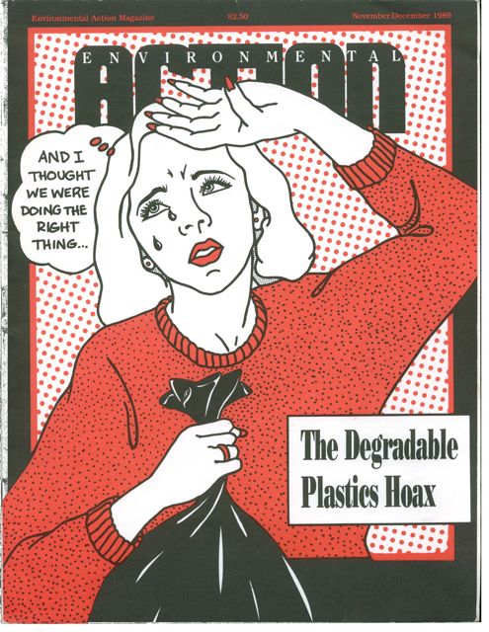
Degradable Vs. Biodegradable
Degradable
May be invisible to naked eye
Fragment into smaller pieces
No data to document biodegradability within one growing season
Migrate into water table
Not completely assimilated by microbial populations in a short time period
Biodegradable
Completely assimilated into food and energy source by microbial populations in a short time period
Meet biodegradability standards
Source: Dr. Ramani Narayan, Michigan State Univ.

Slide 20
Biodegradable vs. Biobased
Non-biodegradable biobased plastics are here

Slide 21
Composting: A Success Story
Yard Debris,
Thousands of tons
Source: US EPA, 2007 data (http://www.epa.gov/epaoswer/non-hw/muncpl/msw99.htm)
Notes:
64% of yard trimmings composted in 2007

Slide 22
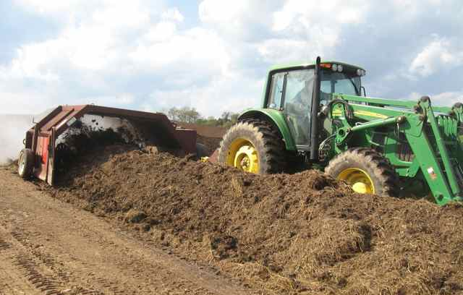
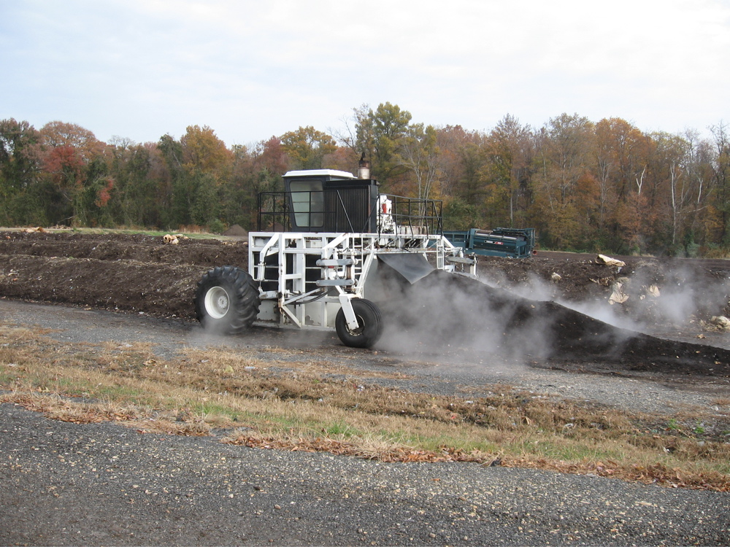
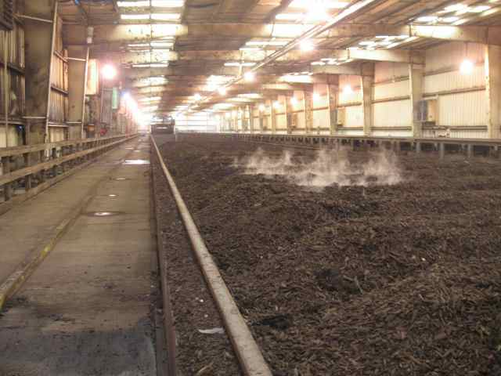
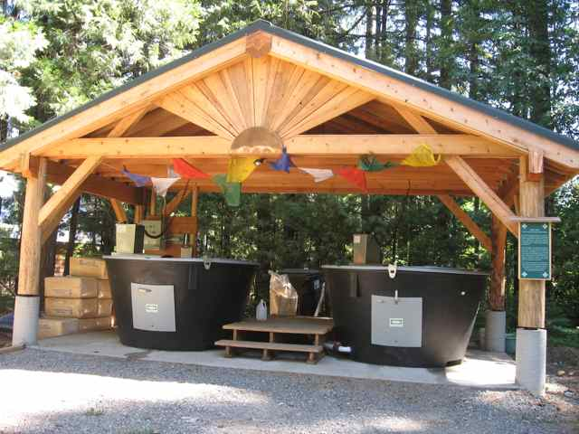
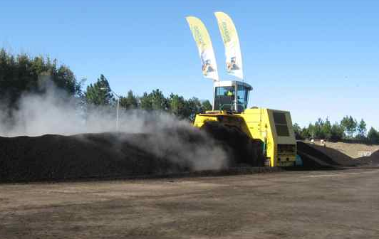
Composting, lots of models

Slide 23
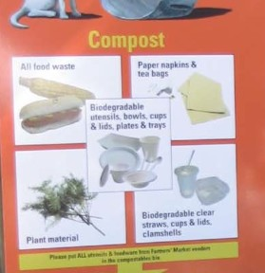
Boulder Farmers’ Market

Slide 24
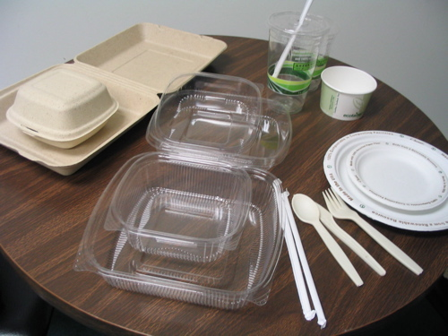
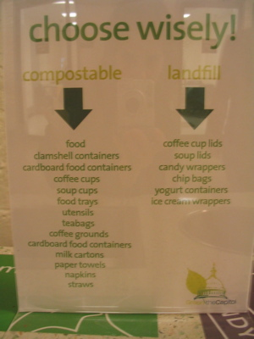
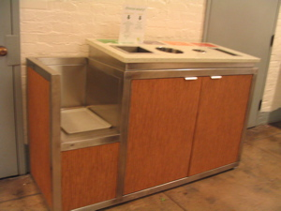
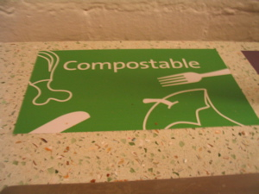
Green the Capitol Initiative

Slide 25
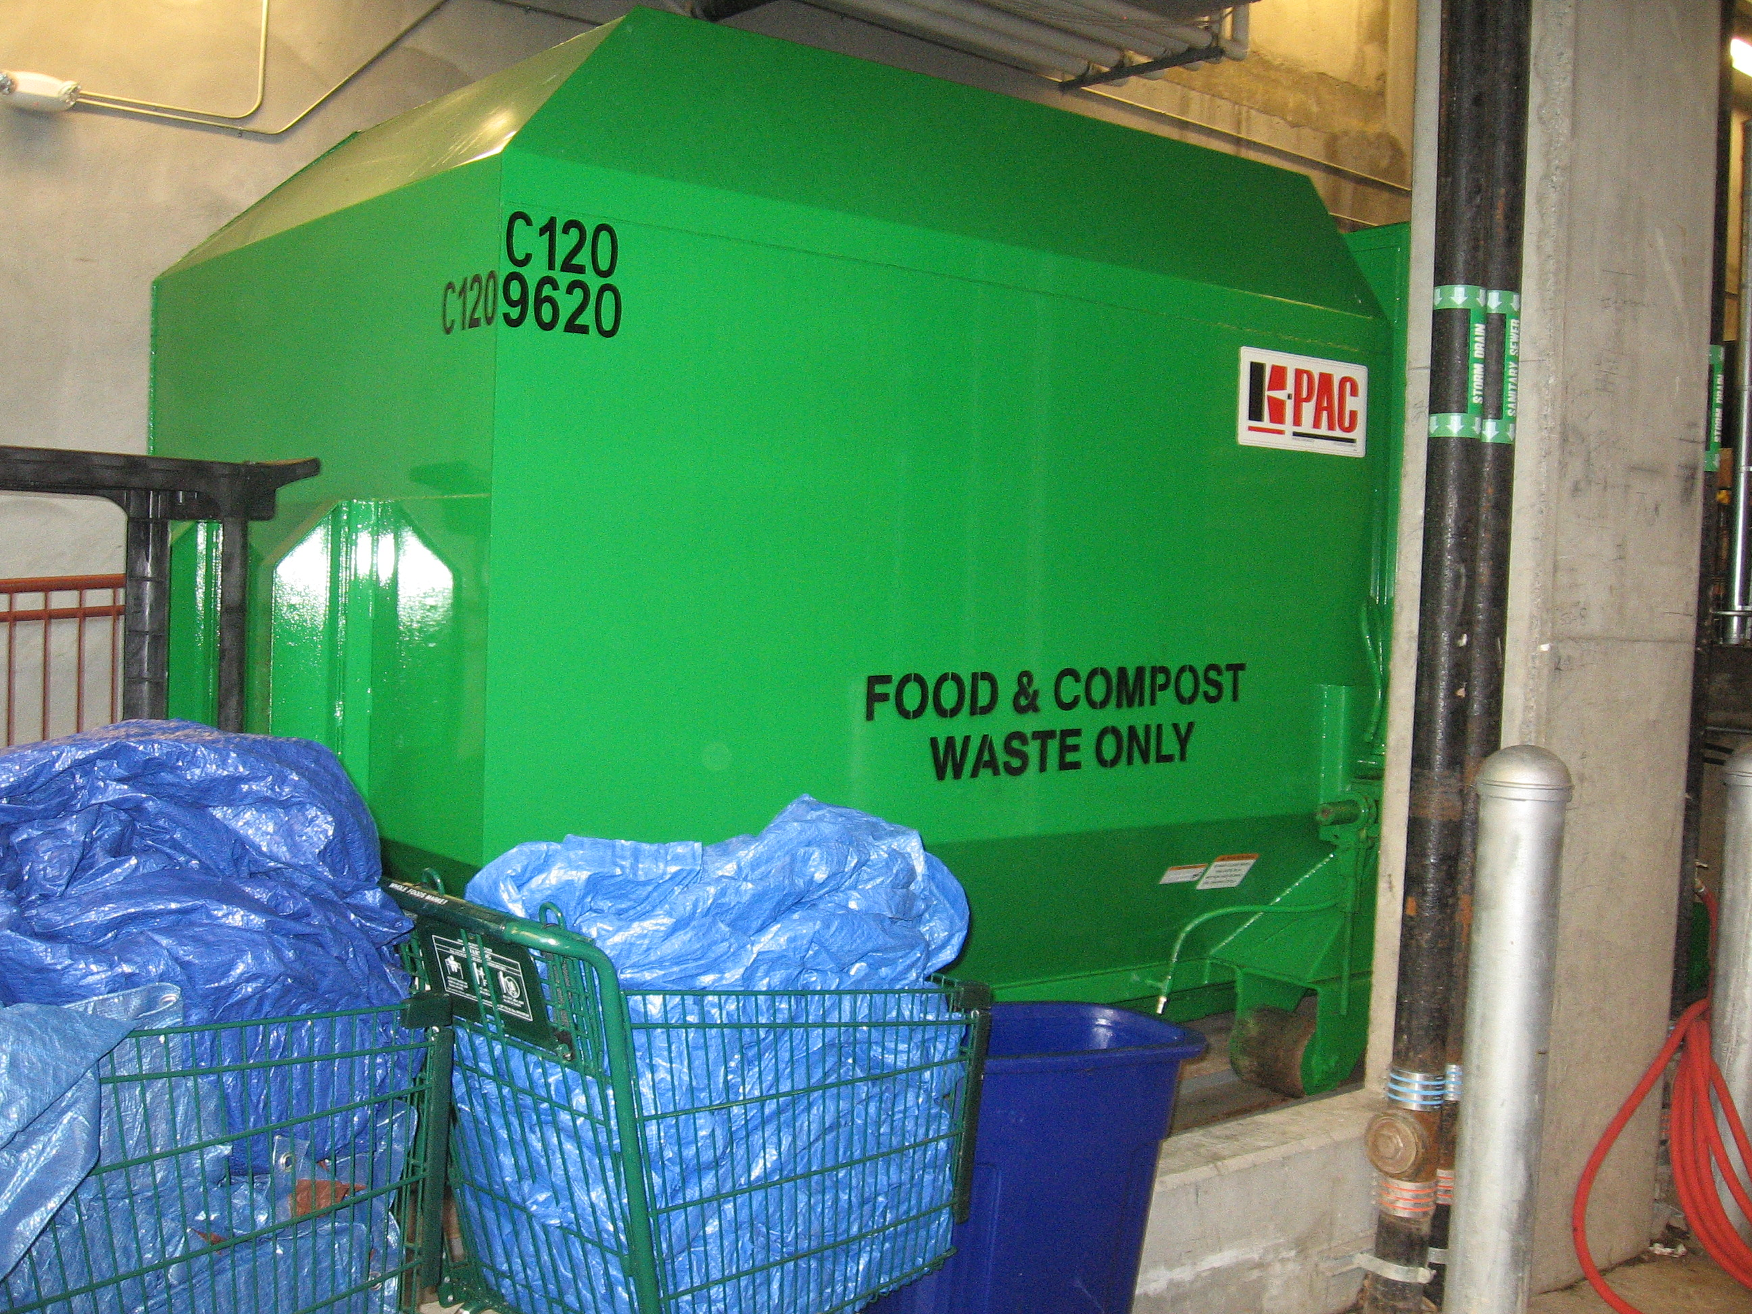
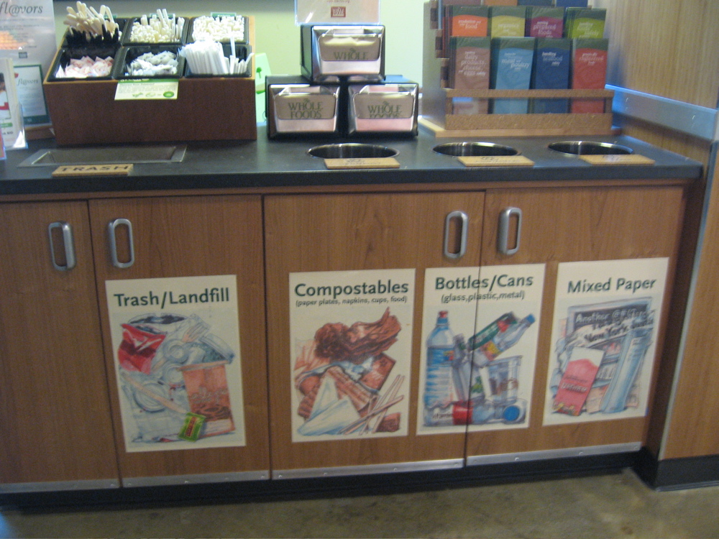
Whole Foods

Slide 26
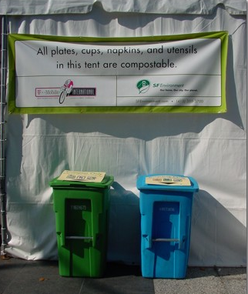
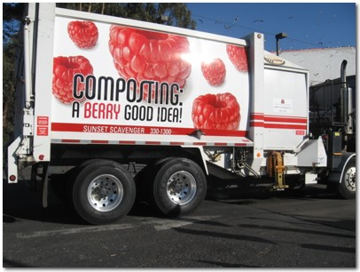
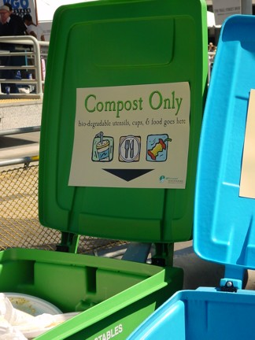
San Francisco: Aiming for Zero Waste

Slide 27
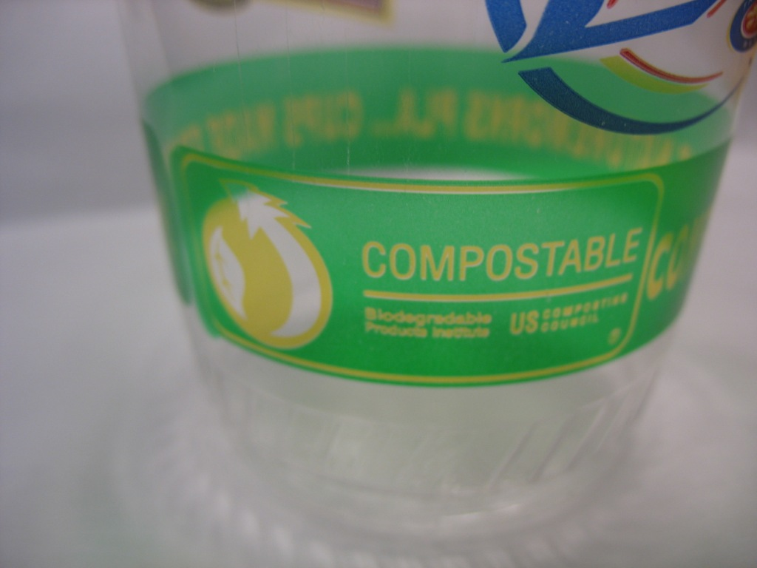
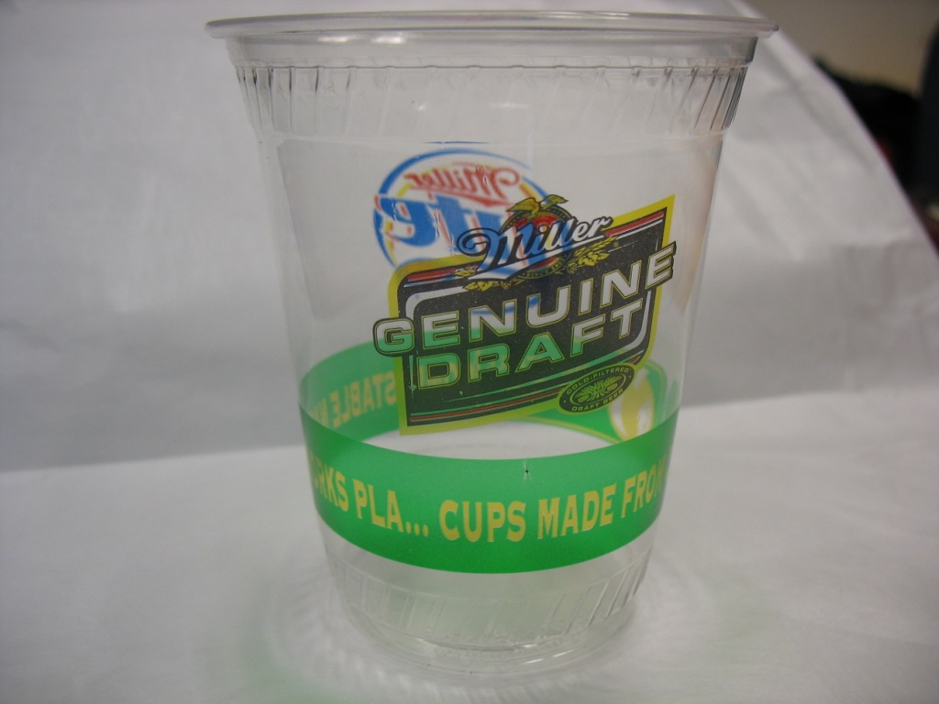
Color-coded compostable design for 400k at SF Festival
Photos courtesy of City of San Francisco

Slide 28
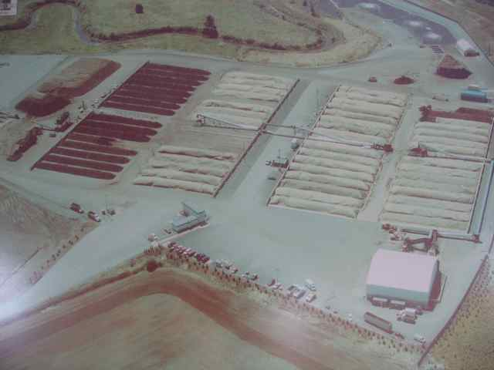
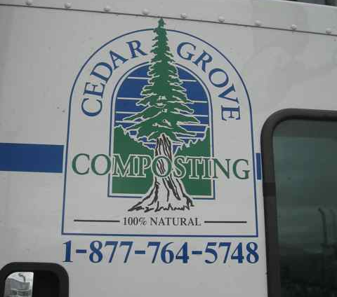
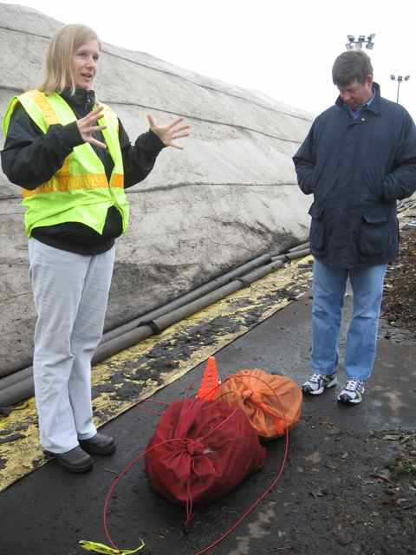
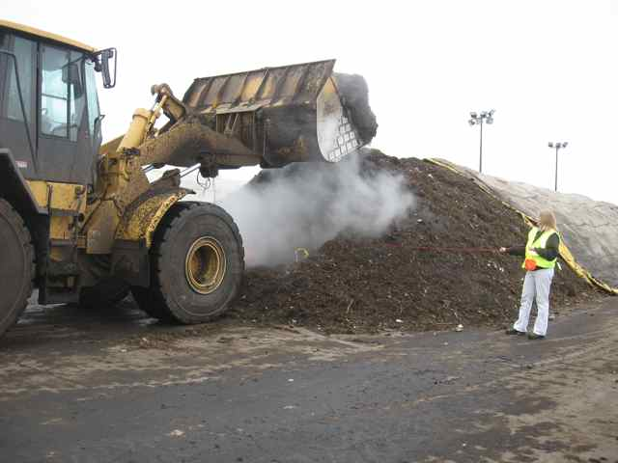
Seattle

Slide 29
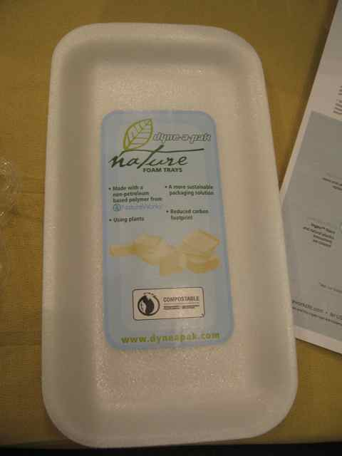
Seattle: Compostable Food Service Ware

Slide 30
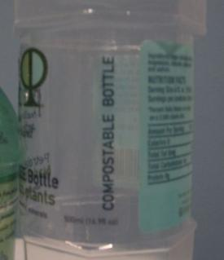
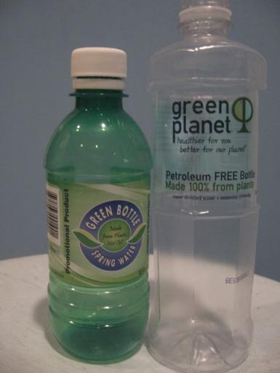
Biomaterial – Wonder Material?
“renewable”
“green
“eco-friendly”
“sustainable”
“environmentally neutral”
“safe and better”
“easy on the environment”
“return to nature without a trace”
Compostability alone ≠ sustainable

Slide 31
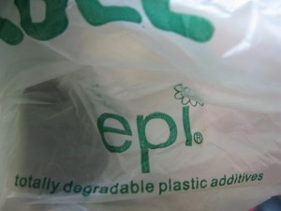
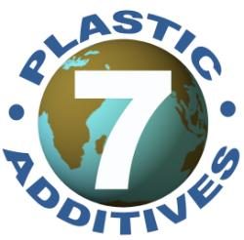
Not All Bioproducts Created Equal
Biobased content
Material feedstock type
Feedstock location
Biodegradability
Commercial compost sites
Home composting
Marine environment
Anaerobic digestion
Additives and blends
Recyclability
Performance
Products

Slide 32
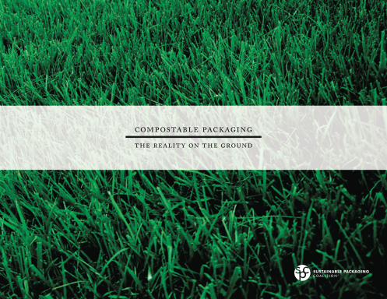
Challenges with Biobased Products
Concern over genetically modified organisms (GMOs)
Desire for sustainably grown biomass
Need to develop adequate composting programs
Concern with nanomaterials and fossil-fuel-plastic blends
Lack of adequate labeling
Concern over contamination of recycling systems

Slide 33
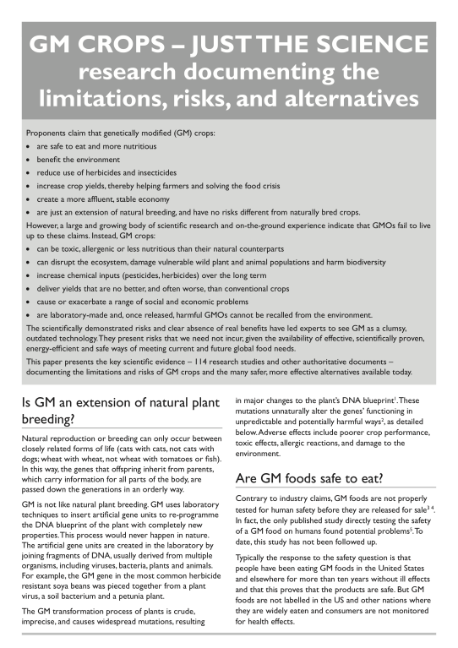
Genetically Modified Crops
Can be toxic, allergenic or less nutritious than their natural counterparts
Can disrupt the ecosystem, damage vulnerable wild plant and animal populations and harm biodiversity
Increase chemical inputs (pesticides, herbicides) over the long term
Deliver yields that are no better, and often worse, than conventional crops
Cause or exacerbate a range of social and economic problems
Are laboratory-made and, once released, harmful GMOs cannot be recalled from the environment.
Source: http://www.nongmoproject.org/
Notes:
According to the USDA, in 2009, 93% of soy, 93% of cotton, and 86% of corn grown in the U.S. were GMO.
Profusion of GM crops make it difficult to directly source non-GM crops for industrial production. A GM-offset program to support non-GM crop production can help address these concerns.

Slide 34
What We Put Into Corn…
Average of over 120 lbs. nitrogen fertilizer per acre
Among the highest levels of herbicide and pesticide use for conventional crops
Irrigation water
Proprietary hybrids
Notes:
34

Slide 35
Sustainable Biomaterials Collaborative
The Sustainable Biomaterials Collaborative is a network of organizations working together to spur the introduction and use of biomaterials that are sustainable from cradle to cradle. The Collaborative is creating sustainability guidelines, engaging markets, and promoting policy initiatives.
As You Sow
Center for Health, Environment and Justice
Clean Production Action *
Environmental Health Fund *
Green Harvest Technologies
Health Care Without Harm
Healthy Building Network
Institute for Agriculture and Trade Policy *
Institute for Local Self-Reliance*
Lowell Center for Sustainable Production *
Sustainable Research Group
Pure Strategies
RecycleWorld Consulting
Science & Environmental Health Network
Seventh Generation
National Campaign for Sustainable Ag.
* Steering committee
Notes:
The Sustainable Biomaterials Collaborative is a network of organizations working together to spur the introduction and use of biomaterials that are sustainable from cradle to cradle.
The Collaborative seeks to
advance the development and diffusion of sustainable biomaterials by creating sustainability guidelines,
engaging markets, and promoting policy initiatives.

Slide 36
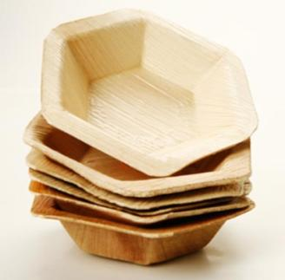
Survey Data: feedstock types and sources
China
Bulrush
Bagasse
PSM (Plastarch Material)
Corn
Chinese PLA
PHBV*
PBS**
Cornstarch
India
Fallen palm leaves
Thailand/Vietnam
Tapioca starch
Grass fiber
Bagasse
Malaysia
Palm fiber
USA
NatureWorks PLA
“Natural total chlorine-free pulp”
Recycled wood fiber
*polyhydroxybutyrate-polyhydroxyvalerate
**polybutylene succinate (petrochemical + succinic acid)
Notes:
1 company is “looking at sourcing byproduct of French fry industry (much of which is used for animal feed) so as not to have impact on food crops”
PBS--1,4-butanediol (a petrochemical) and succinic acid (a product of fermenting sugar cane or corn)

Slide 37
Path from Field to Producer
“The source product is from Brazil,
then turned into cornstarch in China,
then the starch is used in
our manufacturer’s facility.”
“Feedstocks grown in Midwestern US.
Manufacture the resin
in Hawthorne, CA today,
but plan to manufacture
in Seymour, IN shortly.”

Slide 38
Defining Sustainable Life Cycles by Principles
Sustainable feedstocks / Sustainable agriculture
Green Chemistry / Clean Production
Closed Loop Systems / Cradle to Cradle / Zero Waste
“Just because it’s biobased, doesn’t make it green”
Notes:
We are not just interested in biomaterials that are sourced from renewable crops or trees. We want feedstocks to be sustainably grown and harvested. We want products without hazardous inputs and impacts, and that are healthy and safe for the environment during use. We also want products designed for recycling or composting and we want the infrastructure built to enable this.
Sustainably grown feedstocks
No hazardous inputs and impacts during production
Healthy and safe during use
Recyclable or compostable and actually recycled and composted

Slide 39
Biomass Feedstock
Avoid hazardous chemicals
Avoid GMOs
Conserve soil & nutrients
Biological diversity
Sustainable agriculture plan
Protect workers

Slide 40
Manufacturing
Support sustainable feedstock
Reduce fossil energy use
Avoid problematic blends & additives
Avoid untested chemicals and engineered nano particles
Design for recycling & composting
Maximize process safety/reduce emissions
Green chemistry
Protect workers
40

Slide 41
End of Life
Compostable or recyclable
Biodegradable in aquatic systems
Adequate product labeling
Adequate recovery infrastructure

Slide 42
www.workinglandscapes.org
Support existing family farmers economically to transition to sustainable farming practices
Enable bioplastic customers to support more sustainable crop production
Do not require “identity-preserve” infrastructure and additional transaction costs
Notes:
42

Slide 43
2010 Corn Production Criteria
www.workinglandscapes.org
No GMO varieties
No continuous cropping
Soil testing and fertilization according to state criteria and test results
No use of known human or animal carcinogenic chemicals
Use of cover crops or at least 70% of residues left on entire field
Creation of whole farm plan that includes biodiversity and energy aspects
Notes:
43

Slide 44
General Statistics
8,680 lbs of corn per acre, anticipated average yield
3,472 lbs of PLA per acre
2.5 lbs of corn for 1 lb of PLA
Each certificate is equivalent to 1 acre
Notes:
General average
Acre-- Not trying to create false incentives to overproduce on the land

Slide 45
WLCs in 2010
Stonyfield Farm is first major buyer of WLCs
Shifted to PLA for multipack yogurt cups
Supports over 500 acres of more sustainable corn production
Equivalent to 200 million cups
Notes:
45

Slide 46
Farmers
Certifies farm practices
Contracts with farmers
Companies
Contracts for WLC
Notes:
Working Landscapes Certificates program was created by the Institute for Agriculture and Trade Policy (IATP) in 2006. Since 2008, IATP and Green Harvest Technologies (GHT) have collaborated to build the program into its present form. Green Harvest is responsible for WLC sales and contracting, while IATP is responsible for farmer outreach and WLC criteria development and verification. Interested companies buy WLCs from GHT, which contracts in the spring with farmers. IATP and GHT set prices ($60/acre in 2010).

Slide 47
WLC available to companies
A pound for pound answer for transition
Assisting businesses to transition to biobased materials and products
Enable bioplastic customers to support more sustainable crop production
A pathway to more sustainable biobased production
Joe , WLC Farmer

Slide 48
Development of Environmentally Preferable Purchasing Specifications
Notes:
Purchasers are looking for sustainable products, especially those that are environmentally-conscoius
Initial focus was to develop a road map and best practices for sustainability → birth of Guidelines
From the guidelines, need for wise purchasing decisions → BioSpecs (will be making a series of, the current one focuses on biobased food service ware; which = cutlery, cups, bowls, plates, napkins, trays, deli carry out, etc)

Slide 49
Recognition Levels
Bronze
Baseline criteria
Easily verifiable criteria
Silver
Gold
Highest level
More challenges to verify criteria
Notes:
Designed like an ecolabel, but isn’t one

Slide 50
Criteria: Biomass Production
Criteria | Recognition Level
Biobased (organic) carbon content Product must be >90% Product must be >95% Product must be >99% | Bronze Silver Gold
Genetically Modified Plants No plastics may be made directly in plants GM crops allowed in field with offsets No GM biomass allowed in field | Bronze Bronze Silver
Sustainably grown biomass Forest and brushland-derived biomass Agricultural crop biomass | Bronze Gold
Protection of biomass production workers | Gold
www.sustainablebiomaterials.org

Slide 51
Criteria: Manufacturing
Criteria | Recognition Level
Wood- or fiber-based products Non-food-contact products: 100% recycled, 40% PCR Cups: 10% PCR content Other food-contact products: 45% recycled content | Bronze Silver Bronze
No organohalogens added | Bronze
Additives and Contaminants of High Concern Declare whether nanomaterials present No additives that are chemicals of high concern No engineered nano without health risk assessment All additives must be tested | Bronze Bronze Silver Gold
No chlorine or chlorine compounds | Silver
Protection of biomass production workers | Gold
Local ownership and production | Gold

Slide 52
Criteria: End of Life
Criteria | Recognition Level
Product must be 100% commercially compostable | Bronze
Product labeled for compostability “Commercially Compostable” if facility exists Verification logo on product Clearly compostable Additional labeling if facility does not exist | Bronze Bronze Bronze Bronze
100% backyard or home compostable | Silver
100% biodegradable in aquatic environment Marine biodegradable Freshwater biodegradable | Gold Gold

Slide 53
Next Steps
Vetted List of Products
Clear process for manufacturers to assess conformance to criteria
Beta-test conformance process
Work with purchasers to beta-test bid specs
Expand Working Landscape Certificates
Notes:
Using life cycle thinking to define sustainability
Criteria are based off of a market survey performed 2 years ago: 22 companies and 42 products surveyed
By performing market survey, and creating criteria that are achievable by current market, we feel we can drive the market to sustainability (otherwise companies would give up on and refuse to be part of it)

Slide 54
Parting Thoughts
Life cycle thinking – taking a “principle-based” approach to sustainable materials
Define what we want
Set priorities
Sustainable feedstocks
Green chemistry
Cradle to cradle
Need to expand composting and anaerobic digestion capacity
corporate support for infrastructure and policies
Transitioning from fossil fuels to renewable, biobased feedstocks
Biobased not inherently better
Need criteria & standards for defining sustainable biomaterials and plastics across their life cycle
No GMOs in field
Inherently safer chems
Concerns with nano
Reuse, recycle, compost
www.sustainablebiomaterials.org

Slide 55
Single use has got to go

Slide 56
Resource Conservation Hierarchy
Most Preferable
Avoid & Reduce
Reuse
Recycle & Compost
Treat
Dispose
Least Preferable

Slide 57
Zero Waste Path

Slide 58
Aiming for zero waste is key GHG abatement strategy
Abatement Megatons % of Abatement
Strategy CO₂ eq. Needed in 2030 to
Return to 1990
Reducing waste
via prevention, reuse,
recycling, composting 406 11.6%
Lighting 240 6.9%
Vehicle Efficiency 195 5.6%
Lower Carbon Fuels 100 2.9%
Forest Management 110 3.1%
Carbon Capture & Storage 95 2.7%
Wind 120 3.4%
Nuclear 70 2.0%
Source: ILSR, GAIA, and Eco-Cycle, Stop Trashing the Climate (2008), and McKinsey & Company, Reducing U.S. Greenhouse Gas Emissions: How Much and at What Cost? (2007)
Notes:
By 2030, we’d need to reduce US ghg by 3.5 gigatons to return to 1990 levels.

Slide 60
Comments? Questions?
Brenda Platt
SBC, Co-Chair Institute for Local Self-Reliance, Co-Director
bplatt@ilsr.org
202-898-1610 ext 230
For information on the purchase of Working Landscapes Certificates:
David Levine SBC, Steering Committee Member American Sustainable Business Council, Executive Director
Green Harvest Technologies, Founding Partner dlevine@asbcouncil.org 917-359-9623
For information on the Working Landscapes Certificate criteria and verification:
Jim Kleinschmit
SBC, Steering Committee Member Institute for Agriculture and Trade Policy, Rural Communities Program
Director
jimk@iatp.org 612-870-3430
www.sustainablebiomaterials.org
Notes:
Contact me for more information, to be an early adopter, etc.

