Slide 1
ECO Manatee DEMs February 9, 2023 Bradenton, FL
Elemental Impact
SOIL & WATER:
the foundation of life
Holly Elmore
Elemental Impact
Founder & CEO

Slide 2
Recycling Refinement
Ei Era of Recycling Refinement:
Founded in 2010 as the home to the Zero Waste Zones.
The forerunner in the nation for the commercial collection of food waste for compost.
Launched the Sustainable Food Court Initiative in 2011.
First SFCI Pilot: the Atlanta Airport, the busiest airport in the world.

Slide 3
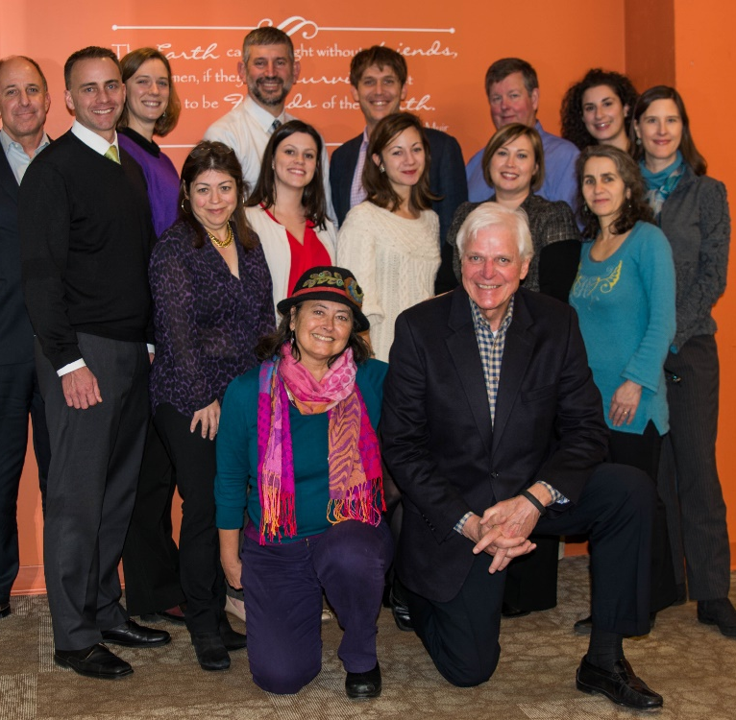
Recycling Refinement
Ei Era of Recycling Refinement:
Hosted the Sustainable F&B Packaging Value Chain Meetings 2011 – 2014.
Non-profit and industry trade association
executives traveled to Washington D.C. for the
annual meeting.
Mission Accomplished: June 2017.
Ei entered the Era of Regeneration.

Slide 4
Elemental Impact
Regeneration in ACTION
Work with industry leaders to create best regenerative operating practices where the entire value chain benefits, including corporate bottom lines and the environment. Through education and collaboration, establish the best practices as standard practices.

Slide 5
A Catalyst
Ei is a creator, an incubator.
Ei determines what could be done that is not being done and gets it done.
Ei brings the possible out of impossible.
Ei identifies pioneers and creates heroes.

Slide 6
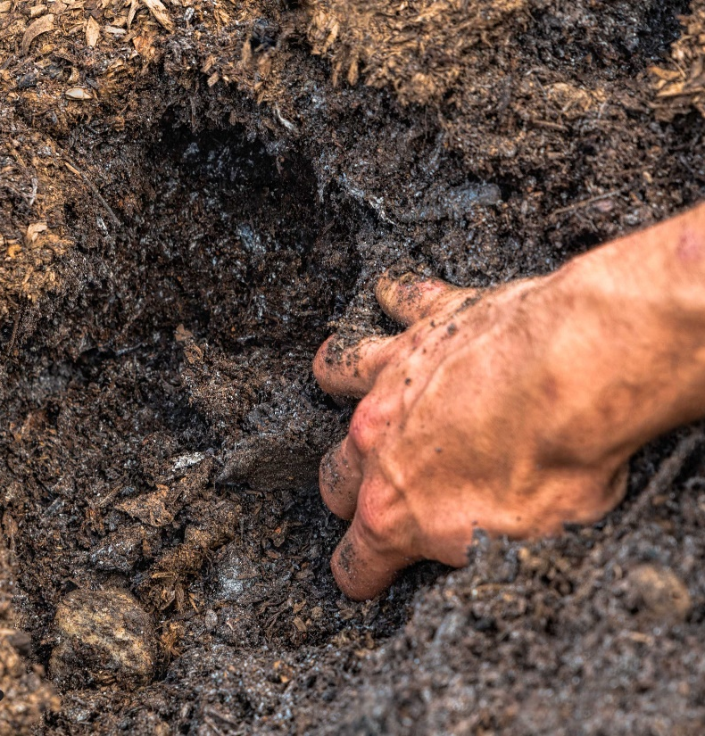
Soil & Water: Foundation of Life
Soil & Water: Foundation of Life
Water and soil are in a Divine marriage and must be addressed together.
Water and soil are the foundation of all life on Earth.
Insects are integral to soil ecosystems and the base of the prey hierarchy.

Slide 7
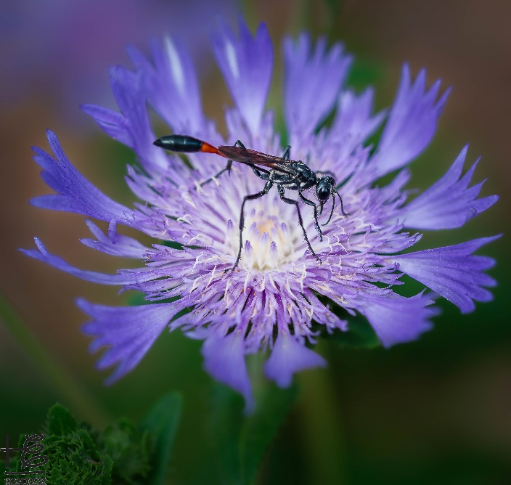
Insect Apocalypse
Insect Apocalypse
Insects have declined by 75% in the past 50 years.
41% of insect species are threatened with extinction.
Insects play a critical role in ecosystems
Provide food for fish, mammals, reptiles, amphibians,
and birds.
Pollinate flowering plants in wild and agriculture ecosystems.
Play an essential role in the decomposition portion of
nature’s circular-life cycle.
Recycle soil-system nutrients.

Slide 8
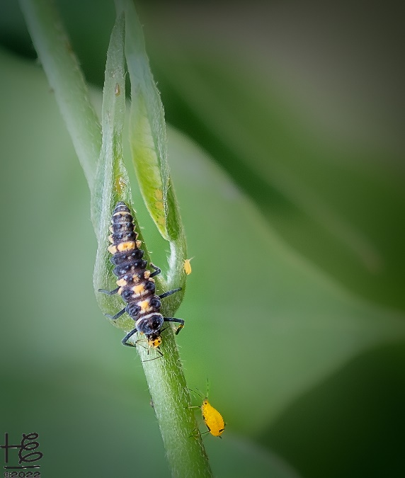
Insect Apocalypse
Insect Apocalypse
Contributing factors to the demise of insect populations:
Pesticides – prolific use in landscape & grounds maintenance, gardening & agriculture, and other
pest control.
Loss of habitat – due to urbanization,
transportation systems, farming, and
landscape-maintenance practices.

Slide 9
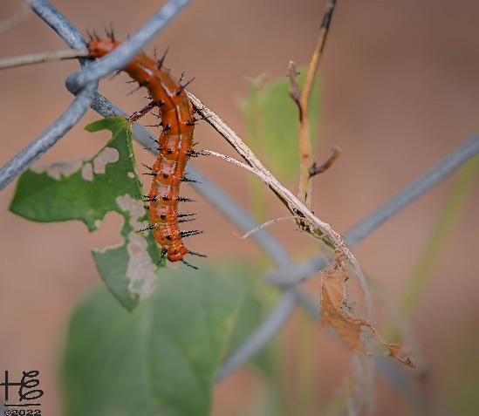
Insect Apocalypse
Insect Apocalypse
Contributing factors to the demise of insect populations:
Non-native plants in landscapes and wild areas –
most are not food or habitat for insects that evolved
in unison with native plants; many symbiotic
relationships.
Intangible pollution – artificial light, noise
(leaf blowers,) and electromagnetic fields.

Slide 10
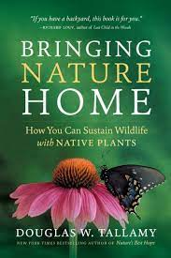
Homegrown National Park
Homegrown National Park
A grassroots call-to-action to regenerate biodiversity.
“In the past, we have asked one thing of our gardens: that they be pretty. Now they have to support life, sequester carbon, feed pollinators and manage water.”
— DOUG TALLAMY
Link: Doug’s Bringing Nature Home presentation

Slide 11
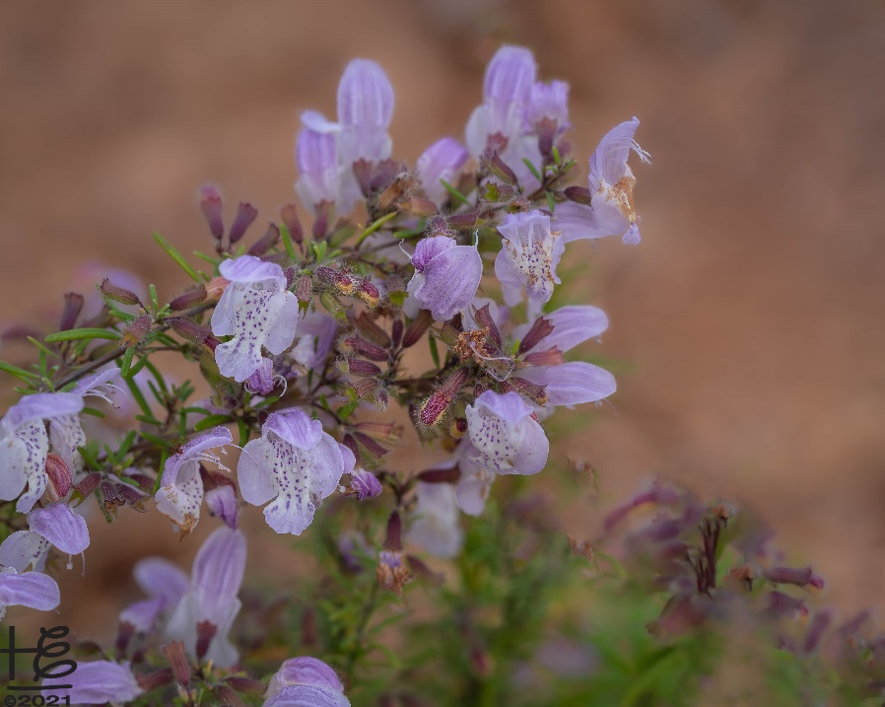
Homegrown National Park
Homegrown National Park
A grassroots call-to-action to regenerate biodiversity.
SOLUTION:
PLANT NATIVE

Slide 12
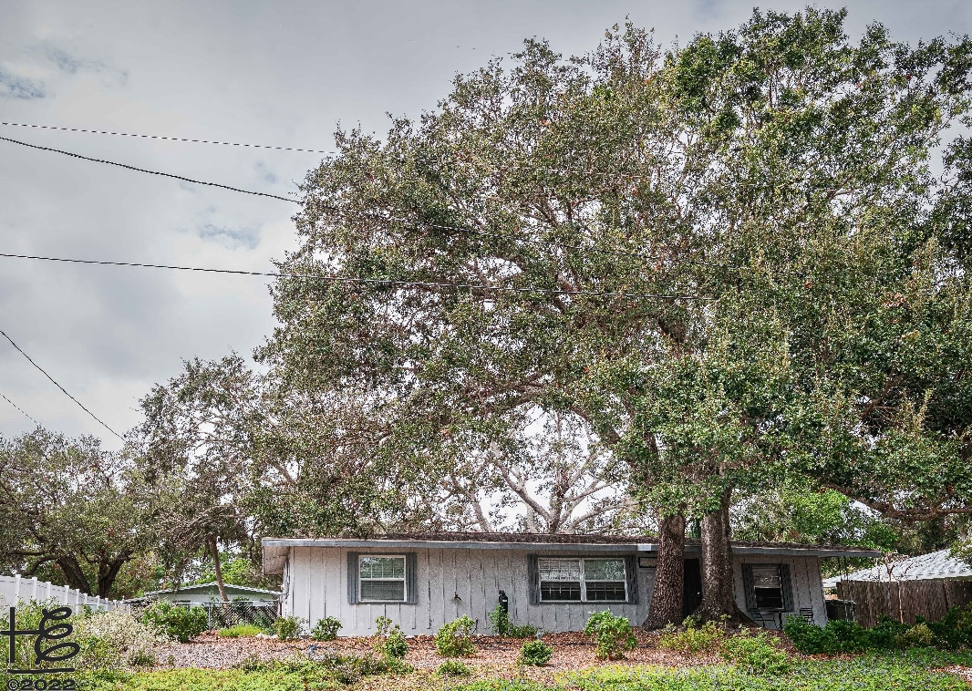
Homegrown National Park
Ei Native-Plant-Landscape Pilot
Intention: to create a thriving environment for urban-wildlife habitat and food.

Slide 13
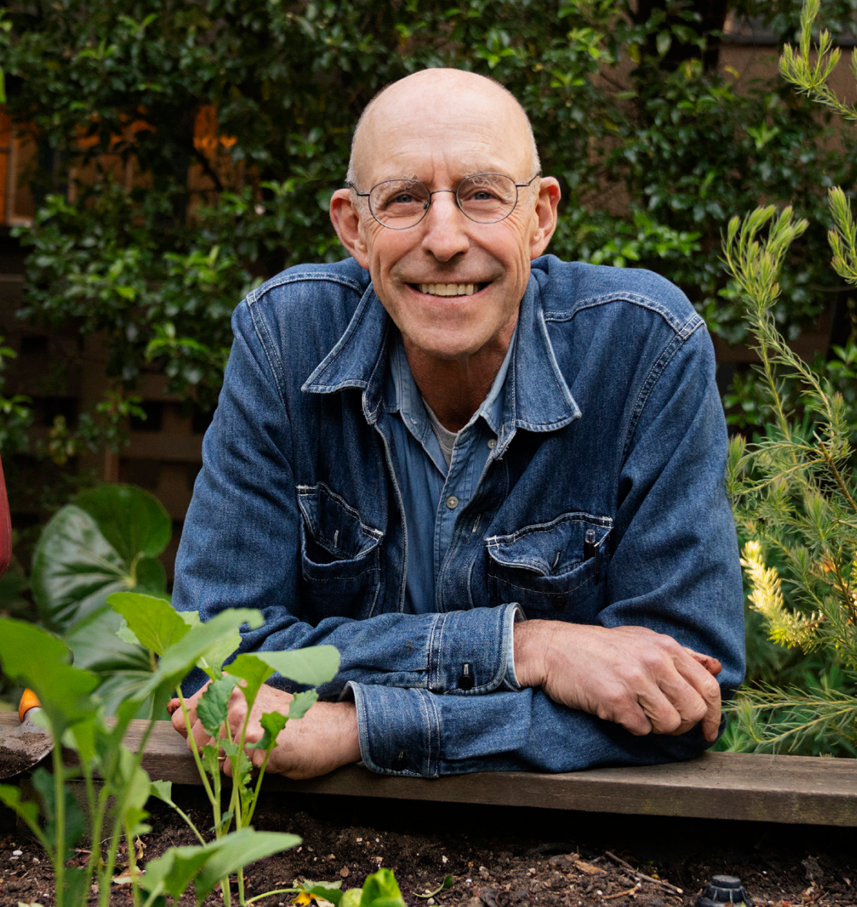
Intentional Eating
Intentional Eating
Michael Pollan: Food is not just fuel. Food is about family, food is about community, food is about identity. We nourish all those things when we eat well.

Slide 14
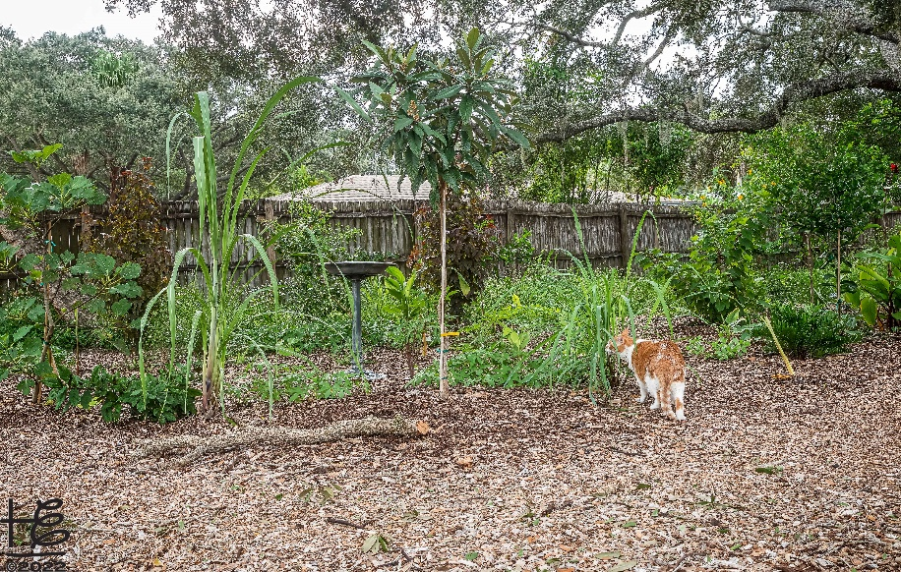
Intentional Eating
Intentional Eating
Article: From Organic Certification to Regenerative Agriculture to Rewilding Landscapes: an evolution towards soil integrity
Wendell Berry: eating is an agricultural act.
Evolution towards soil integrity
Organic – toxic-free food; does not address the soil; food often lacks nutrients.
Regenerative – soil focus yet no emphasis on native plants.
Rewilding – focus on native plants.
Permaculture – if not native, plant must produce human food.

Slide 15
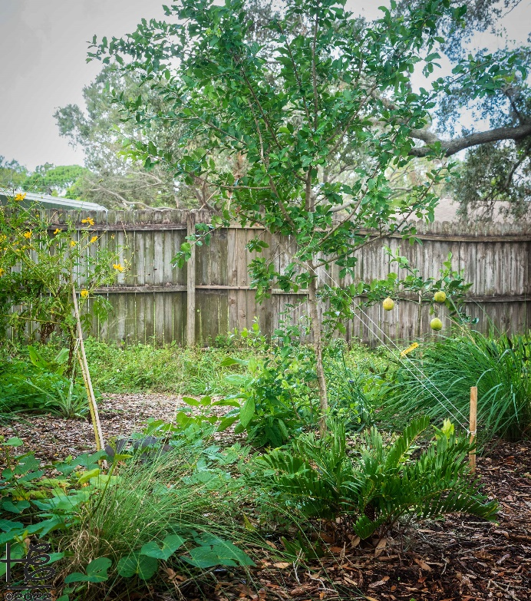
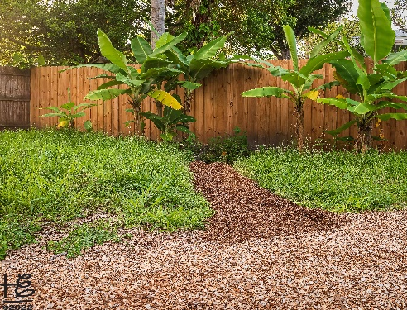
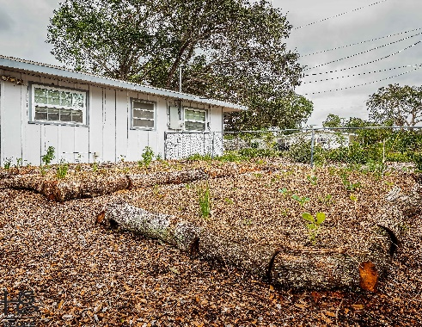
Intentional Eating
Ei Permaculture-Backyard Pilot
Intention: to produce healthy, nutritious human food while cultivating soil health.

Slide 16
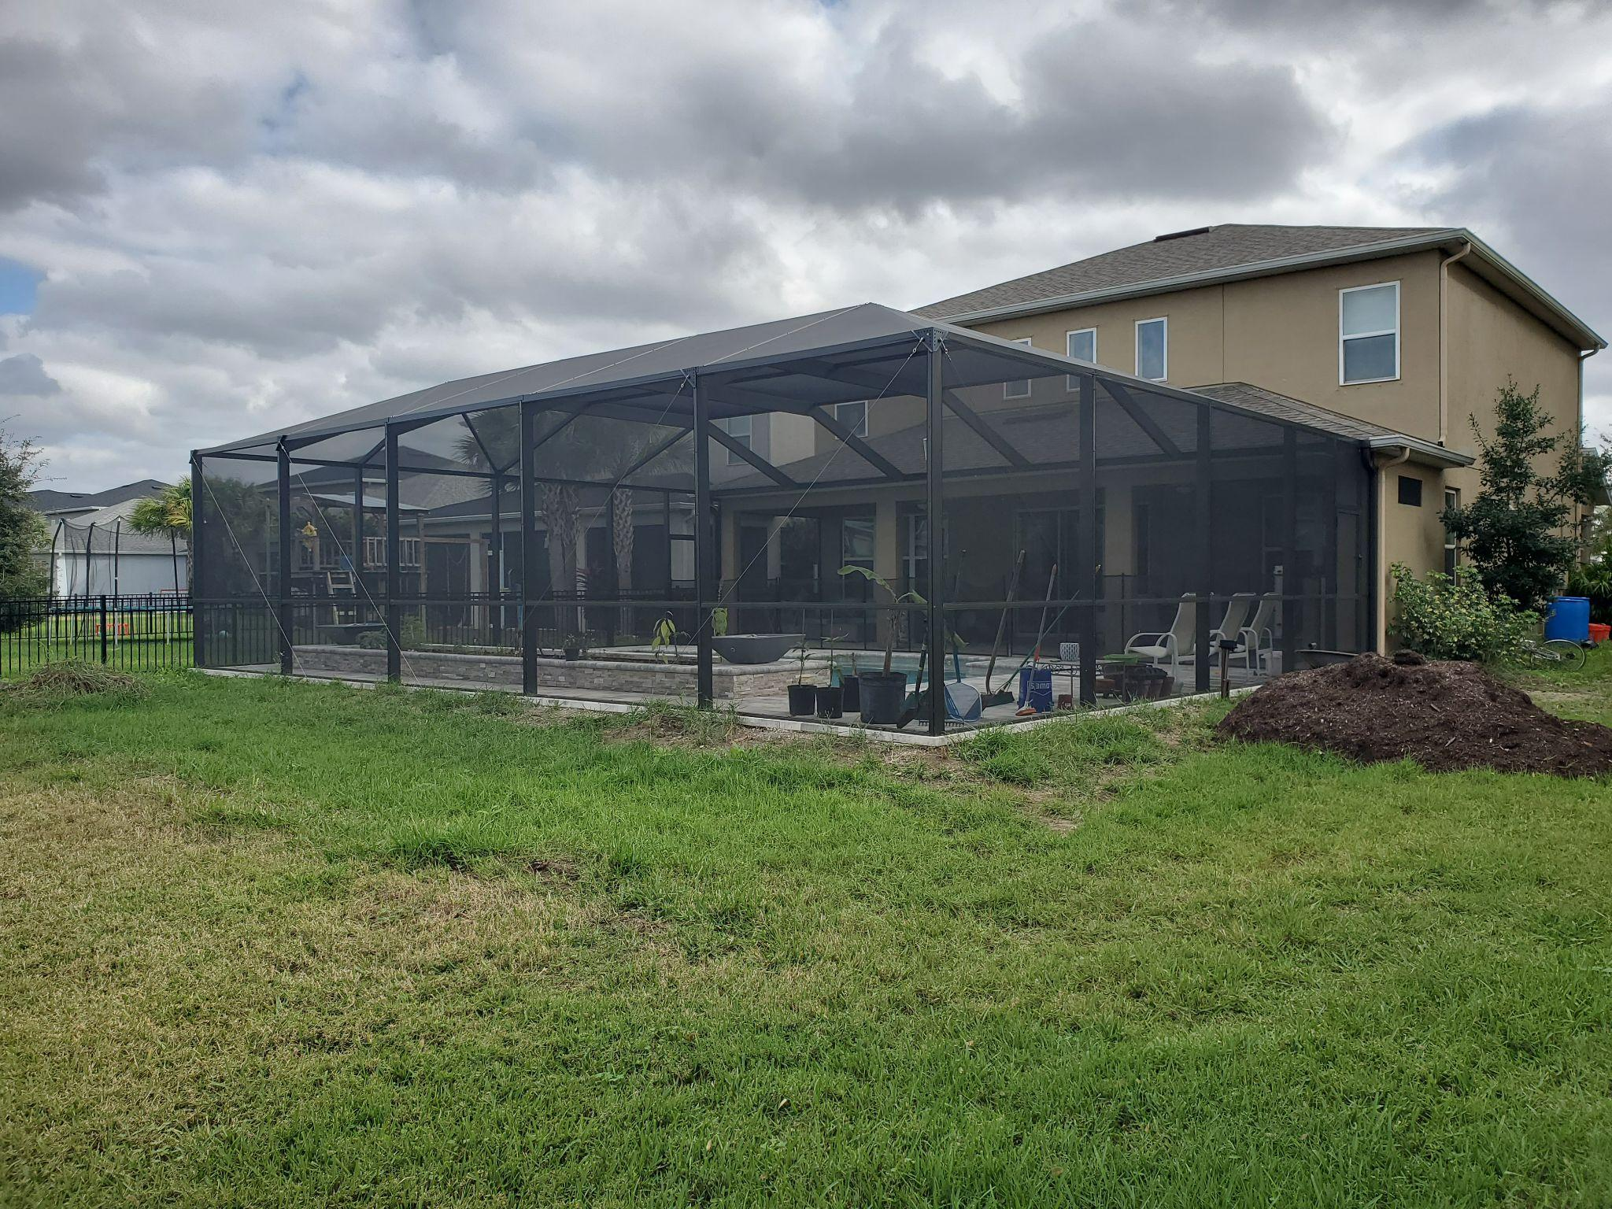
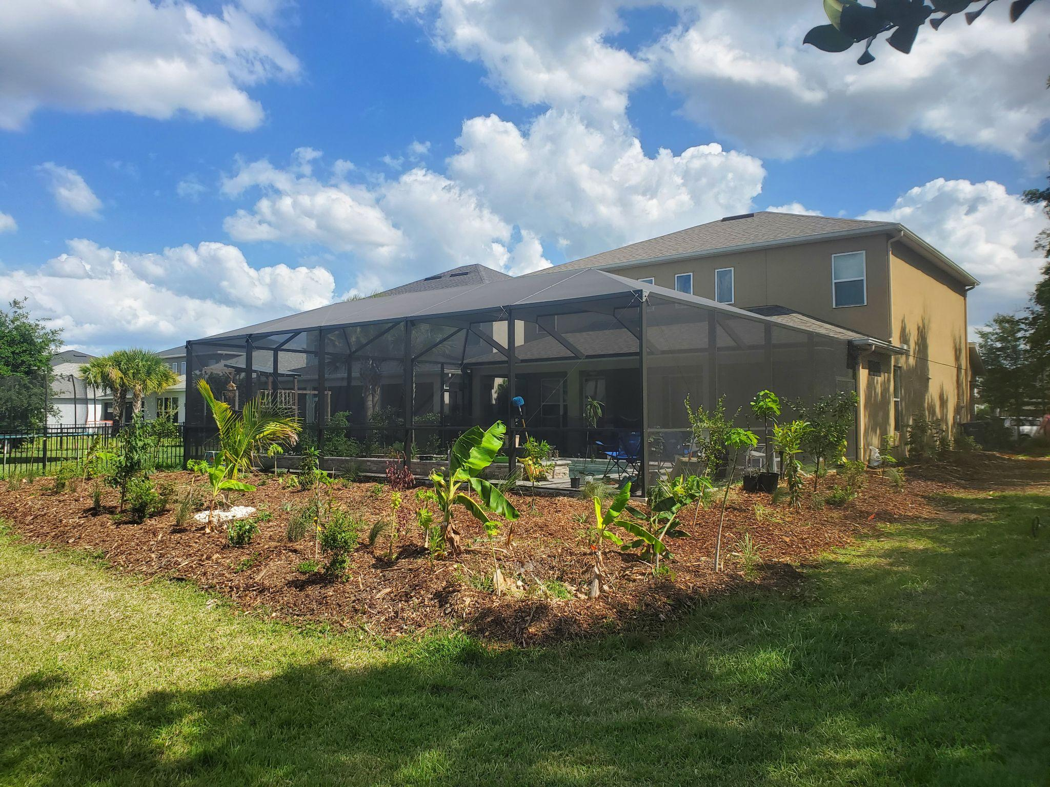
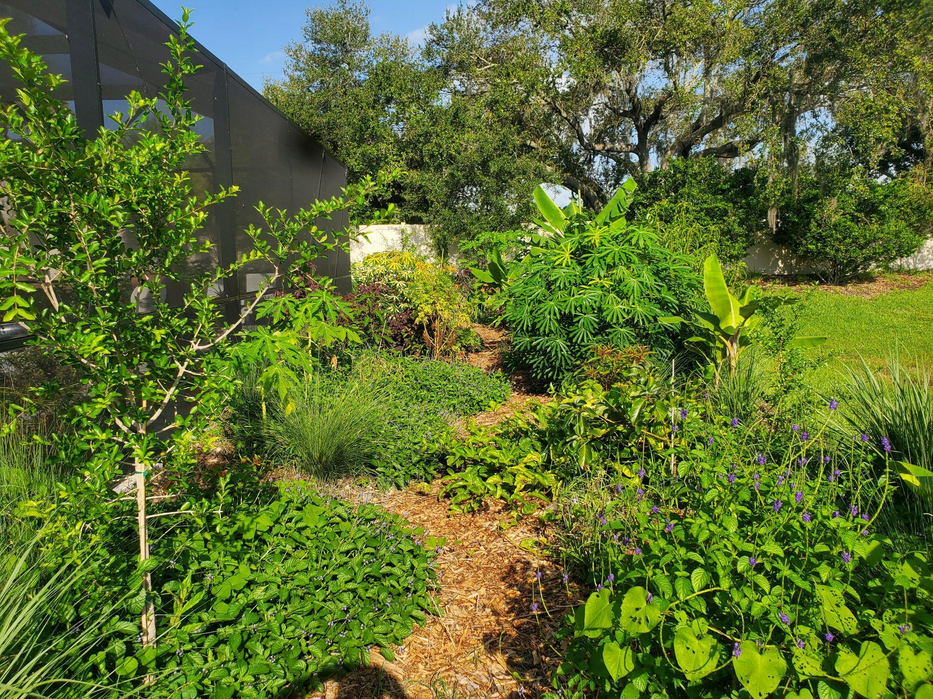
ZZ Design Services
Permaculture-Oriented Landscapes
Intention: nutrient capture and cycling, carbon capture, minimizing inputs/maximizing outputs, food security, connection to natural systems
Components:
Food forest (perennial food production)
Vegetable & herb gardens
Compost
Before
After
3 months later

Slide 17
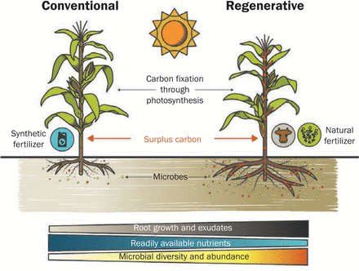
ZZ Design Services
Soil Regeneration
Intention: create a positive feedback loop promoting a natural balance of soil nutrients and organisms
Soil carbon content - key factor in most metrics of soil health and primary factor in plant growth.
biological activity, moisture retention, pH, bioavailability of nutrients.
Healthy soil = healthy resilient plants = less inputs & more nutritious food.
Image courtesy of article: Managing plant surplus carbon to generate soil organic matter in regenerative agriculture by Cindy E. Prescott
Notes:
-soil carbon content plays most significant role in soil and plant health because it is fundamental for microbial and plant growth. even with other nutrients present plants cannot
-

Slide 18
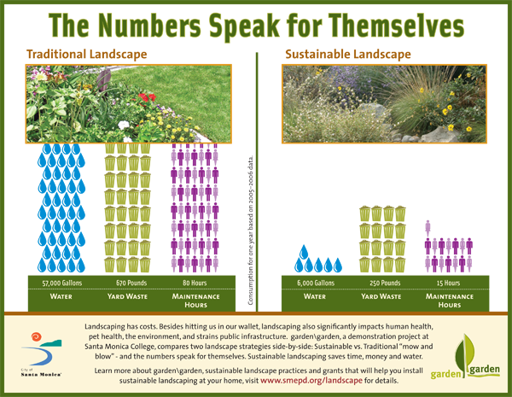
ZZ Design Services
What can you do?
Intention: cumulative small action by the collective community results in huge impact
Plant native plants.
Leave the leaves; insect pupation & nutrients for soil.
Eliminate petro-chemical fertilizers, toxic- herbicides & pesticides.
Educate yourself on local resources.
FNPS, Sarasota Audubon, Transition Sarasota

Slide 19
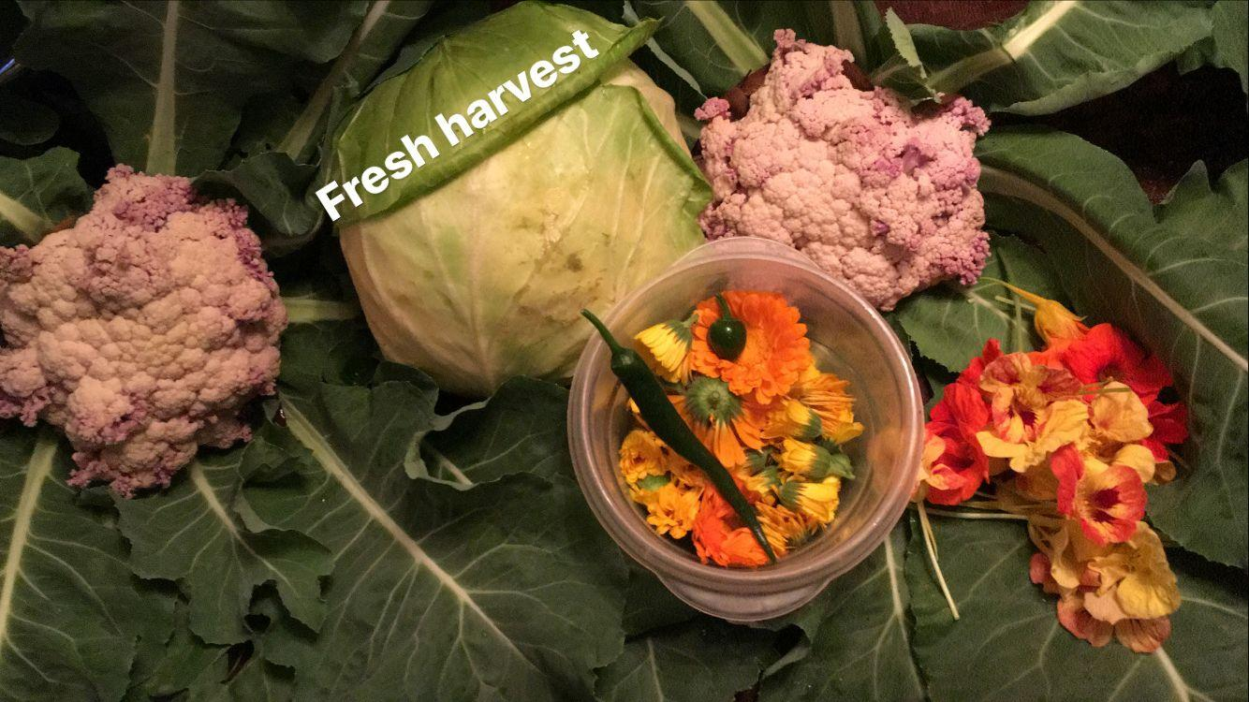
ZZ Design Services
What can you do?
Intention: cumulative small action by the collective community results in huge impact
Vote with your consumer $$; shop local and seasonal when possible.
Get to know your local farmers.
Grow your own food; start simple.
Document your successes and share with friends to learn from and inspire others.
Take baby steps, lots & lots of baby steps.

Slide 20
Contact Information
Thank you!
Holly Elmore
holly@elementalimpact.org
404.510.9336
/elementalimpact
@elementalimpact
@elementalimpact
Zach Zildjian
FoodForestDesigns@gmail.com
413.230.4688

